Slide 1
Genome Assembly
BIS180L
Julin Maloof
Some slides from Matt Davis

Slide 2
Genome Assembly Overview
Chromosomes are often 10s to 100s of megabases in length
Even the longest read technologies only give reads 10-100 kilobases long
Genetic, genomic, and evolutionary studies are aided (or need) longer contigs / scaffolds
The ultimate goal is telomere-to-telomere (T-to-T) assemblies

Slide 3
Genome assembly: why?

Slide 4
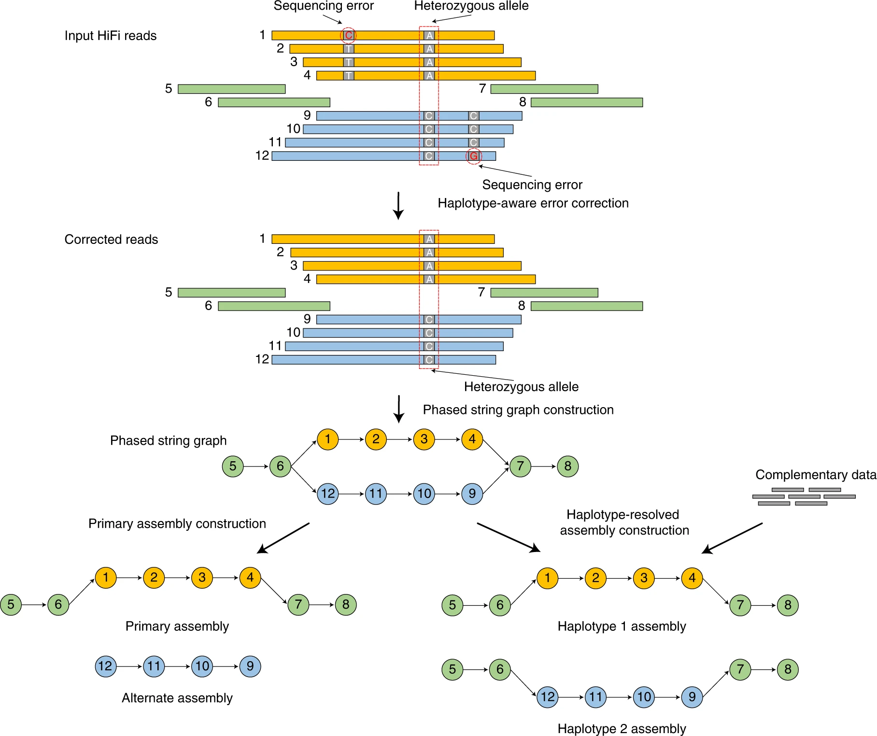
Genome Assembly With HiFiAsm
Align Reads
Correct Errors
Cheng et al (2021), Figure 1

Slide 5
Genome Assembly With HiFiAsm
Align Reads
Correct Errors
Create phased graphs
Separate into haplotypes
Cheng et al (2021), Figure 1

Slide 6
Pacific Biosciences
Create a cell with an array of millions of tiny fluorescence detector wells
Affix DNA polymerase at the detector
Measure fluorescence of nucleotides as they are added
Single molecule (no cluster needed)
Average read length 10,000 – 15,000 bases
Rhoads and Au 2015 https://doi.org/10.1016/j.gpb.2015.08.002

Slide 7
Pacific Biosciences
Rhoads and Au 2015 https://doi.org/10.1016/j.gpb.2015.08.002

Slide 8
Video (watch on your own time)
Pac Bio Video.
Promotional, but with good graphics
Eric Chow (UCSF) video
PacBio info starts at 23:23 (the link will take you there, but you might want to watch the whole thing)

Slide 9
Read Statistics
Length | Cumulative Sum
1543 | 1543
1500 | 3043
1323 | 4366
1301 | 5667
1276 | 6943
888 | 7831
789 | 8620
777 | 9397
743 | 10140
701 | 10841
654 | 11495
622 | 12117
300 | 12417
121 | 12538
Quality
Min, average and max read length
N50:
Sort reads or contigs from largest to smallest
Compute the running sum
N50 is the length of the shortest read/contig where the running sum has included 50% of the data
Translation: 50% of the data is on reads/contigs of at least X bp in length
What is N50 for the sequences on the right?
Notes:
Total Length: 12538
50% Length: 6269
N50 = 1276

Slide 10
Assembly Statistics: General
Min, avg, max contig length
# of contigs
N50, N90
How do contigs compare to expected number of chromosomes?
How does assembly length compare to expected genome size?
Do contigs go telomere to telomere?

Slide 11
Assembly statistics: BUSCO
Does the genome contain expected genes?
BUSCO:
Benchmarking Universal Single Copy Orthologs
Defined set of expected single copy orthologs
Different sets for different branches on the tree of life:
Assembly evaluation:
What % of BUSCO genes are
Present in the assembly
Complete vs fragmented
Single copy vs duplicated

Slide 12
Ideally, assemblies go telomere to telomere (T2T) What is a telomere?
Deposited by telomerase
Prevent chromosomal degradation
Telomeres are repetitive sequence at the ends of chromosomes
Shortening is associated with aging in somatic cells

Slide 13
Telomeres are hard to assemble
Actual sequence
TTTAGGGTTTAGGGTTTAGGG
Short Reads
Some of these reads are actually from here
These regions are typically collapsed
Long Reads
Long reads can span across repetitive regions into non-repetitive regions. This allows for assembly through these regions

Slide 14
What is a telomere-to-telomere assembly?
CCCTAAACCCTAAACCCTAAA
TTTAGGGTTTAGGGTTTAGGG
A genome assembly where every chromosome is sequenced from telomere-to-telomere
This is very difficult, but is now the gold standard for assemblies
Long read sequencing (like HiFi) along with better assembly software (like HiFiAsm) have enabled telomere-to-telemore assembly

Slide 15
It took 19 years from sequencing the first human genome to achieve a human T2T assembly
The first human genome is published
2003
13 years
19 years
$3 billion
2022
1990
The telomere-to-telomere human genome is published
The Human Genome Project officially begins
It is such a big deal that NCBI has a website for it.

Slide 16
Assembly analysis: comparative genomics
Once we have an assembled genome it might be interesting to compare it to other related genomes.
Many things could be compared: (what?)

Slide 17
Assembly analysis: comparative genomics
Once we have an assembled genome it might be interesting to compare it to other related genomes.
Many things could be compared:
Gene content
Repeat content
Sequence variation (mutations, indels)
Chromosome #
Synteny (are the sequences in the same order in both genomes)
We will do a synteny analysis
Could do it at the gene level or nucleotide level
We haven’t annotated our genome, so will try nucleotide level
Align one genome to the other and see where the regions of similarity are

Slide 18
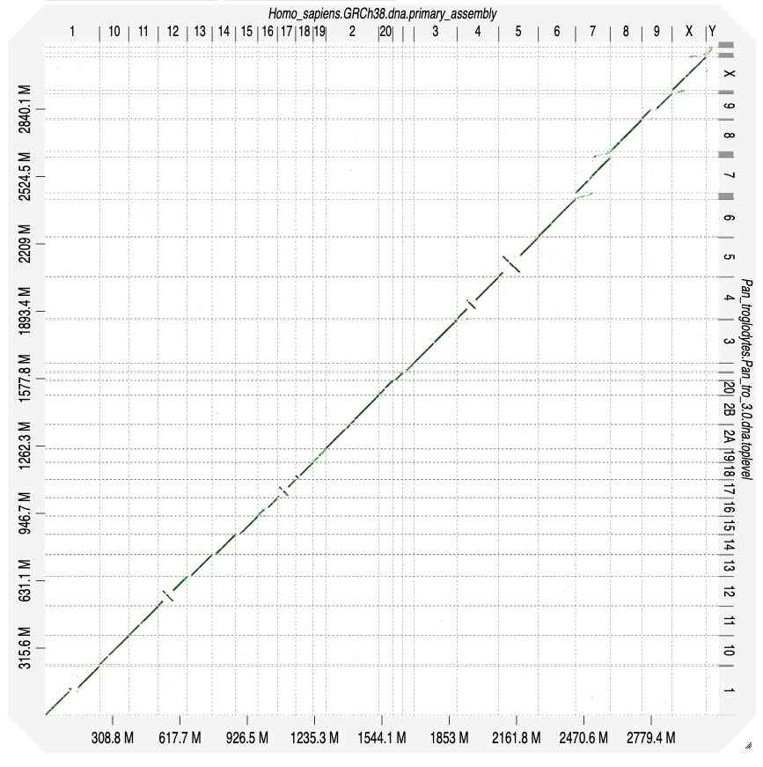
Dot plots are a common way to visualize genomic comparisons
Example on right is humans (x-axis) vs chimp (y-axis)
Dots represent sequence similarity
Demo sheep vs cow at D-GENIES

Slide 19
CONDA Environments
Today we are going to use something called CONDA
CONDA is a tool for managing packages, programs, and add other add-ons
Originally developed for Python, useful for other languages as well
You can create separate “environments” for different tasks or sets of programs
This helps prevent version or package conflicts and can also keep things reproducible
We are using a conda environment for this lab…you will see the code to activate it and install a package

Slide 20
Review Sesson Thursday 5:00 – 6:00, in this room No planned presentation, bring your questions (No obligation to attend)

Slide 21
Important: Run the methylation code at the very end of today’s lab before leaving. We need the results for Thursday

