Slide 1
Methylation Analysis
BIS180L
Julin Maloof and Matt Davis

Slide 2
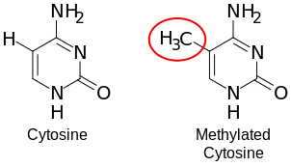
Methylation Overview
Cytosine (C) Residues can be modified by the addition of a methyl group
https://commons.wikimedia.org/wiki/File:DNA_methylation.svg#/media/File:DNA_methylation.svg

Slide 3
Methylation Context and Roles
Cytosine methylation can occur in different sequence contexts
Animals: “CG” aka ”CpG”
Plants: “CG”, “CHH”, “CHG”. Each controlled by different enzymes and with likely different roles
Cytosine methylation
Silencing transposable elements
Regulation of gene expression
Can be dynamic
Role in development
Role in response to environment
Role in imprinting of parental genome
https://commons.wikimedia.org/wiki/File:DNA_methylation.svg#/media/File:DNA_methylation.svg

Slide 4
Cytosine methylation can be measured by PacBio
PacBio
delayed kinetics of base addition.
Complicated signal, requires deep-learning to decode
Accurate
CpG only

Slide 5
Cytosine methylation can be measured by ONT
Oxford Nanopore (ONT)
C vs 5mC cause different current signal across membrane
Accurate
All Contexts. Probably better for plants
Unfortunately, we only have PacBio

Slide 6
Goals / Questions
Extract the `CG` methylation data for the S. diversifolius genome.
Determine if the `CG` methylation marks follow expected patterns in genes.
Calculate methylation proportion for each gene and ask if that corelates with gene expression levels
Display methylation levels across the chromosome and ask if that pattern is non-random at the chromosome level.

Slide 7
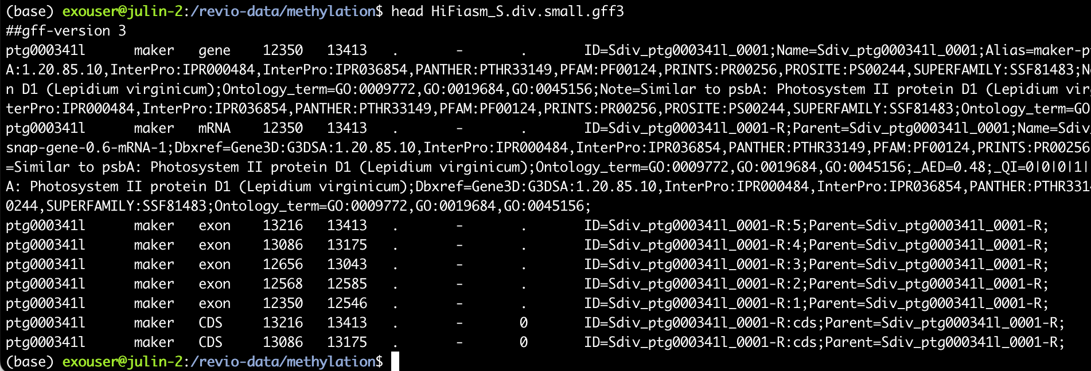
Some file types that you will meet
“.gff” – General Feature Format
Standard for describing the location of features (genes, introns, exons, repeats, etc) in a genome.

Slide 8
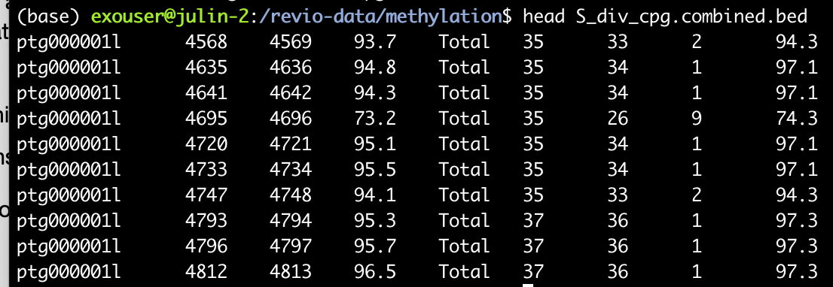
Some file types that you will meet
“bed” – browser extensible data
Simple format to describe an attribute (e.g. CpG) at locations in a genome
First 3 columns are always sequenceID, start, end.
Remaining columns are more flexible

Slide 9
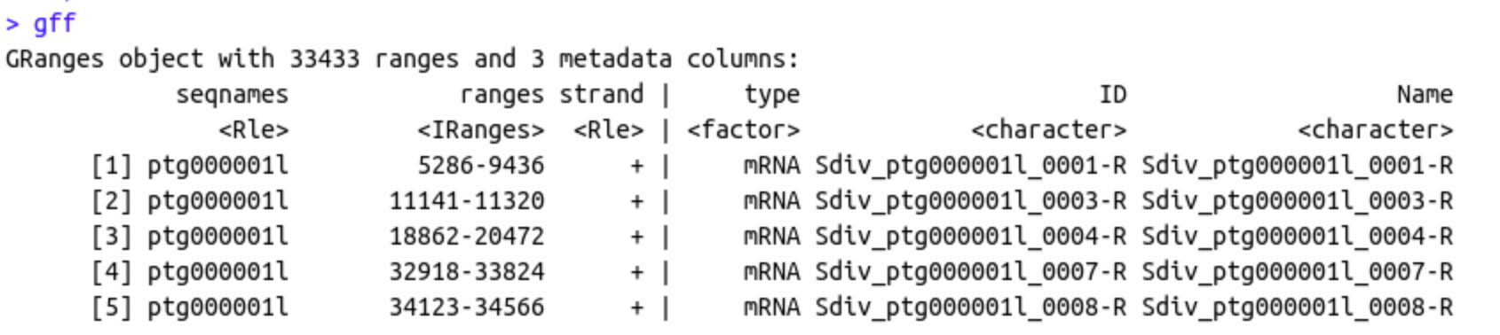
An important R object class: GRanges
The “GRanges” class is used for storing genomic data
Both .bed and .gff files can be represented as Granges
Excellent set operations, overlaps, etc.
Powerful but can be painful

Slide 10
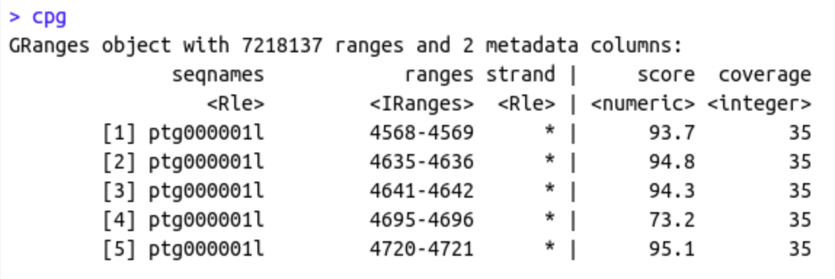
An important R object class: GRanges
The “GRanges” class is used for storing genomic data
Both .bed and .gff files can be represented as Granges
Excellent set operations, overlaps, etc.
Powerful but can be painful

Slide 11
Basic Outline
1. Map Hifi Reads back to the genome assembly (you have already done this)
2. Get methylation percentage for each `CG` site in the genome.
3. Load the data into R.
4. Use R to summarize and analyze the methylation data.

Slide 12
Before we get started…
GWAS and population structure
If your aov(trait ~ popAssignment) is significant (low p-value), then population structure IS a problem for GWAS

Slide 13
Schedule today and upcoming
Today
Finish assembly lab if you have not already done so
Start methylation lab. Okay if you don’t finish today.
4:30 Discussion of assembly lap (esp. dotplots and BUSCO)
5:00 Review for midterm
Tomorrow (Friday)
Midterm Part 1 ( in class)
Administered on Gradescope through Canvas
Must use classroom computer
Midterm Part 2 (take home) released
Tuesday
Work on take home midterm in class. Attendance optional
Thursday
Complete Methylation lab.
Attendance likely optional

Slide 14
Instance resizing
Instances will be resized during in-class exam tomorrow.
Make sure everything is saved and pushed.

Slide 15
Slides from this point on not used in 2026

Slide 16

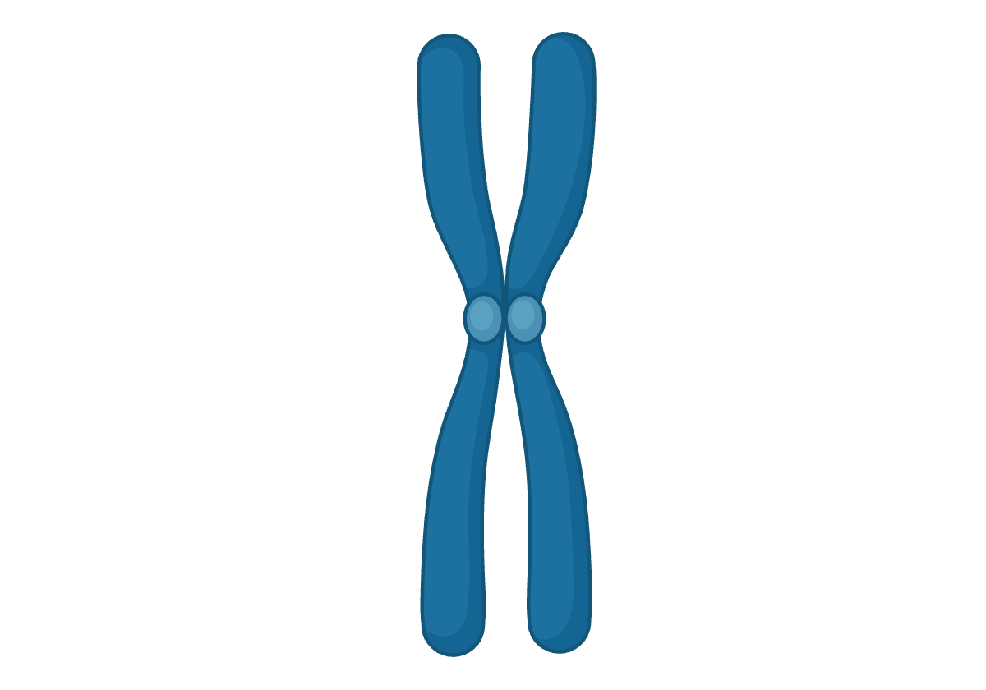
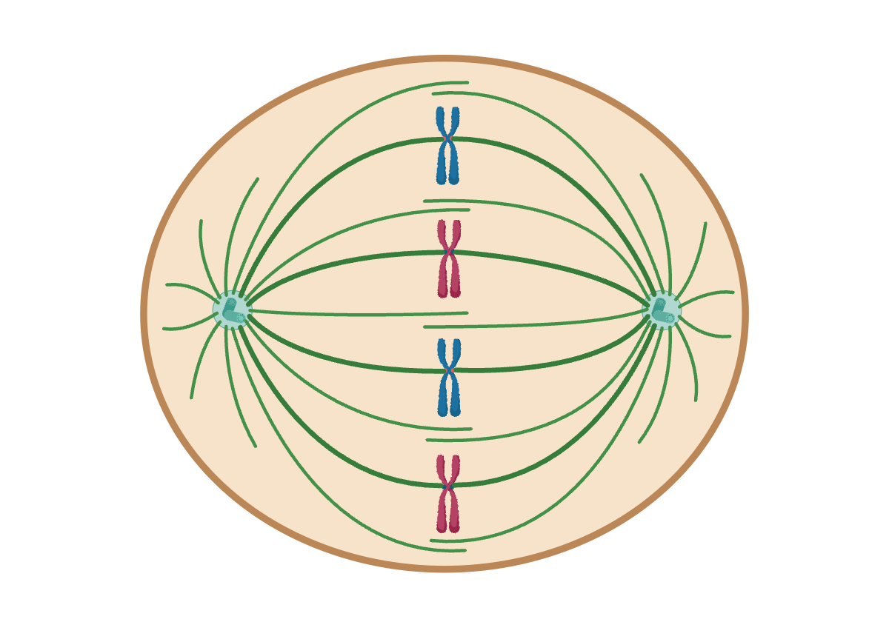
What are centromeres?
They link pairs of sister chromosomes
They are what give chromosomes their characteristic X shape
AATTGGTTAATTGGTTAATTGGTTAATTGGTTAATTGGTT
A lot like telomeres, centromeres are composed of repetitive sequences
They are where the spindle fibers attach during mitosis and meiosis

Slide 17
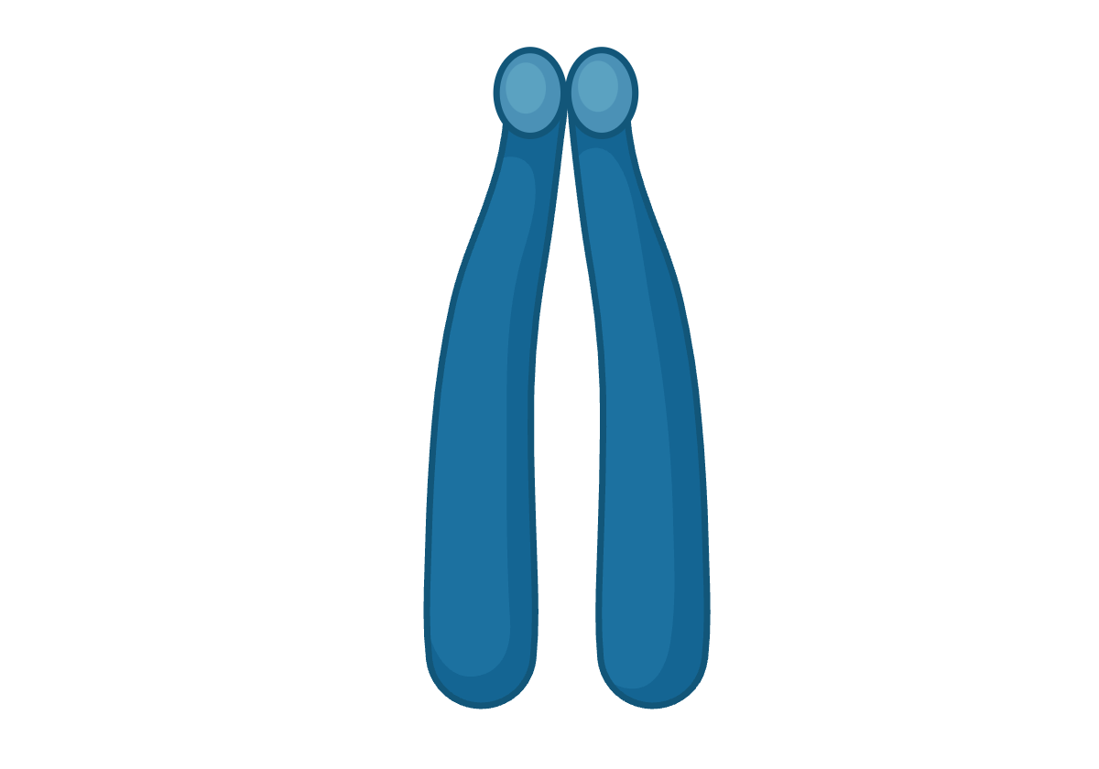
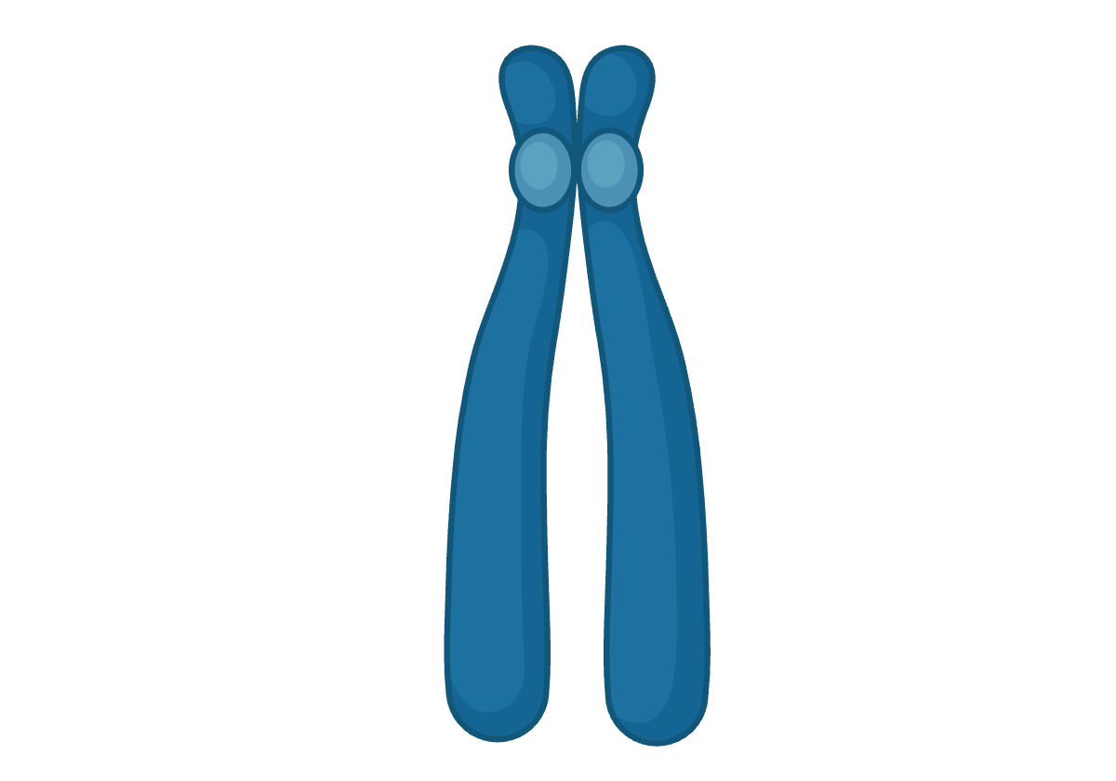
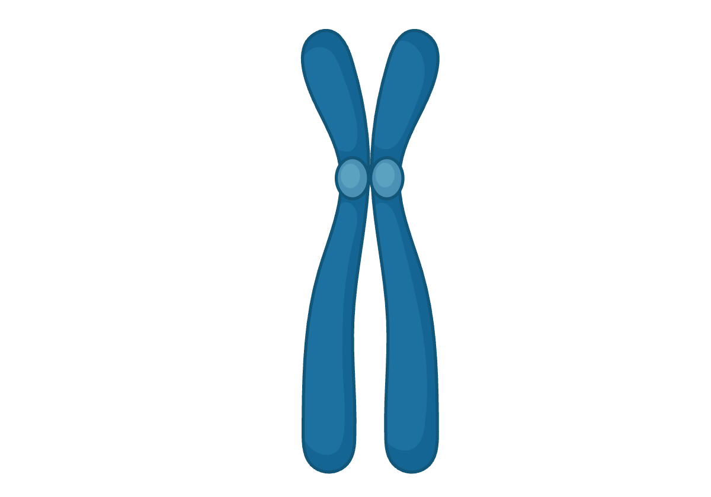
Types of centromeres
Telocentric
Acrocentric
Sub-Metacentric
Metacentric

Slide 18
Dicentric chromosome issues
In Anaphase
chromosomes fragment

Slide 19
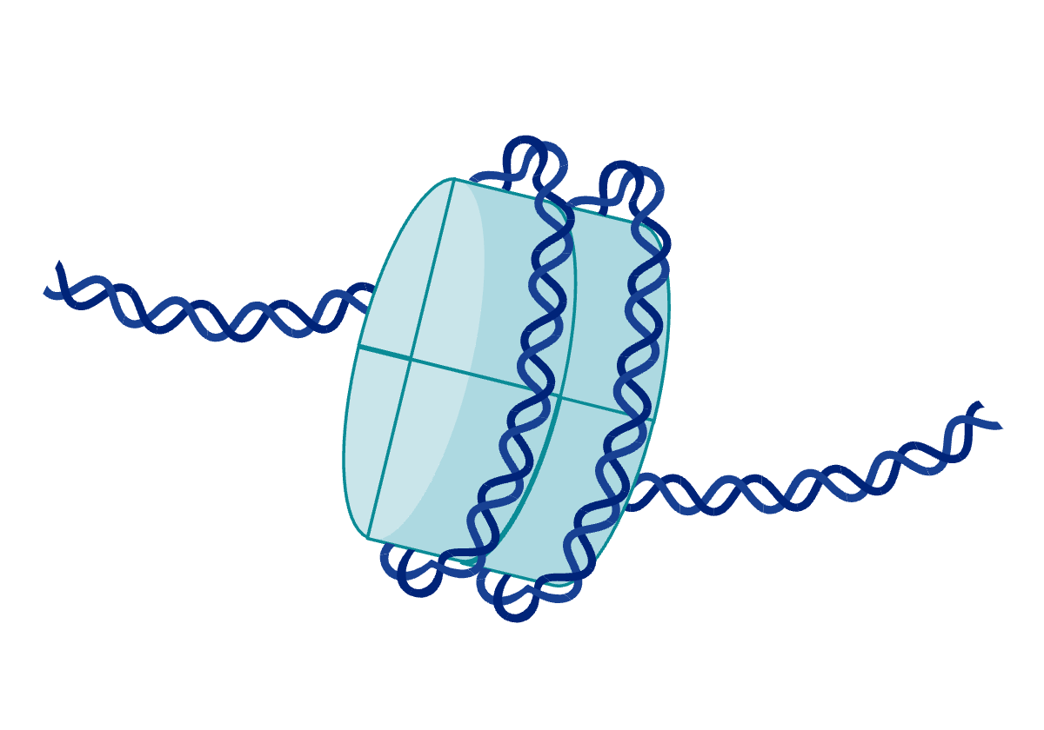

How have we detected centromeres?
Nucleosome
TTTAGGG
Histone CENH3
Telomere sequence is very conserved
Centromeres are epigenetically conserved

Slide 20
Why is it so challenging to detect them bioinformatically?
AAGCCTT
AAGCCTT
GGTTAA
AAGCCTT
CCGGAA
Centromere repeats are not conserved and much longer
The centromeric sequence can vary within a genus
The centromeric sequence can vary between chromosomes

Slide 21
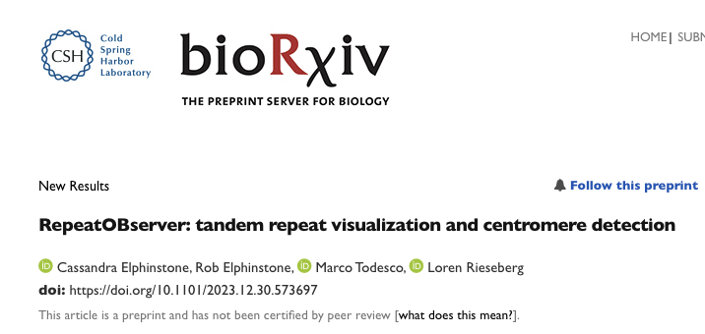
How are we going to approach centromere detection today?
Looking for regions of low sequence diversity. AKA regions with a lot of repeats
Unfortunately this takes a long time. We have run this for you and you will access the data

