Slide 1
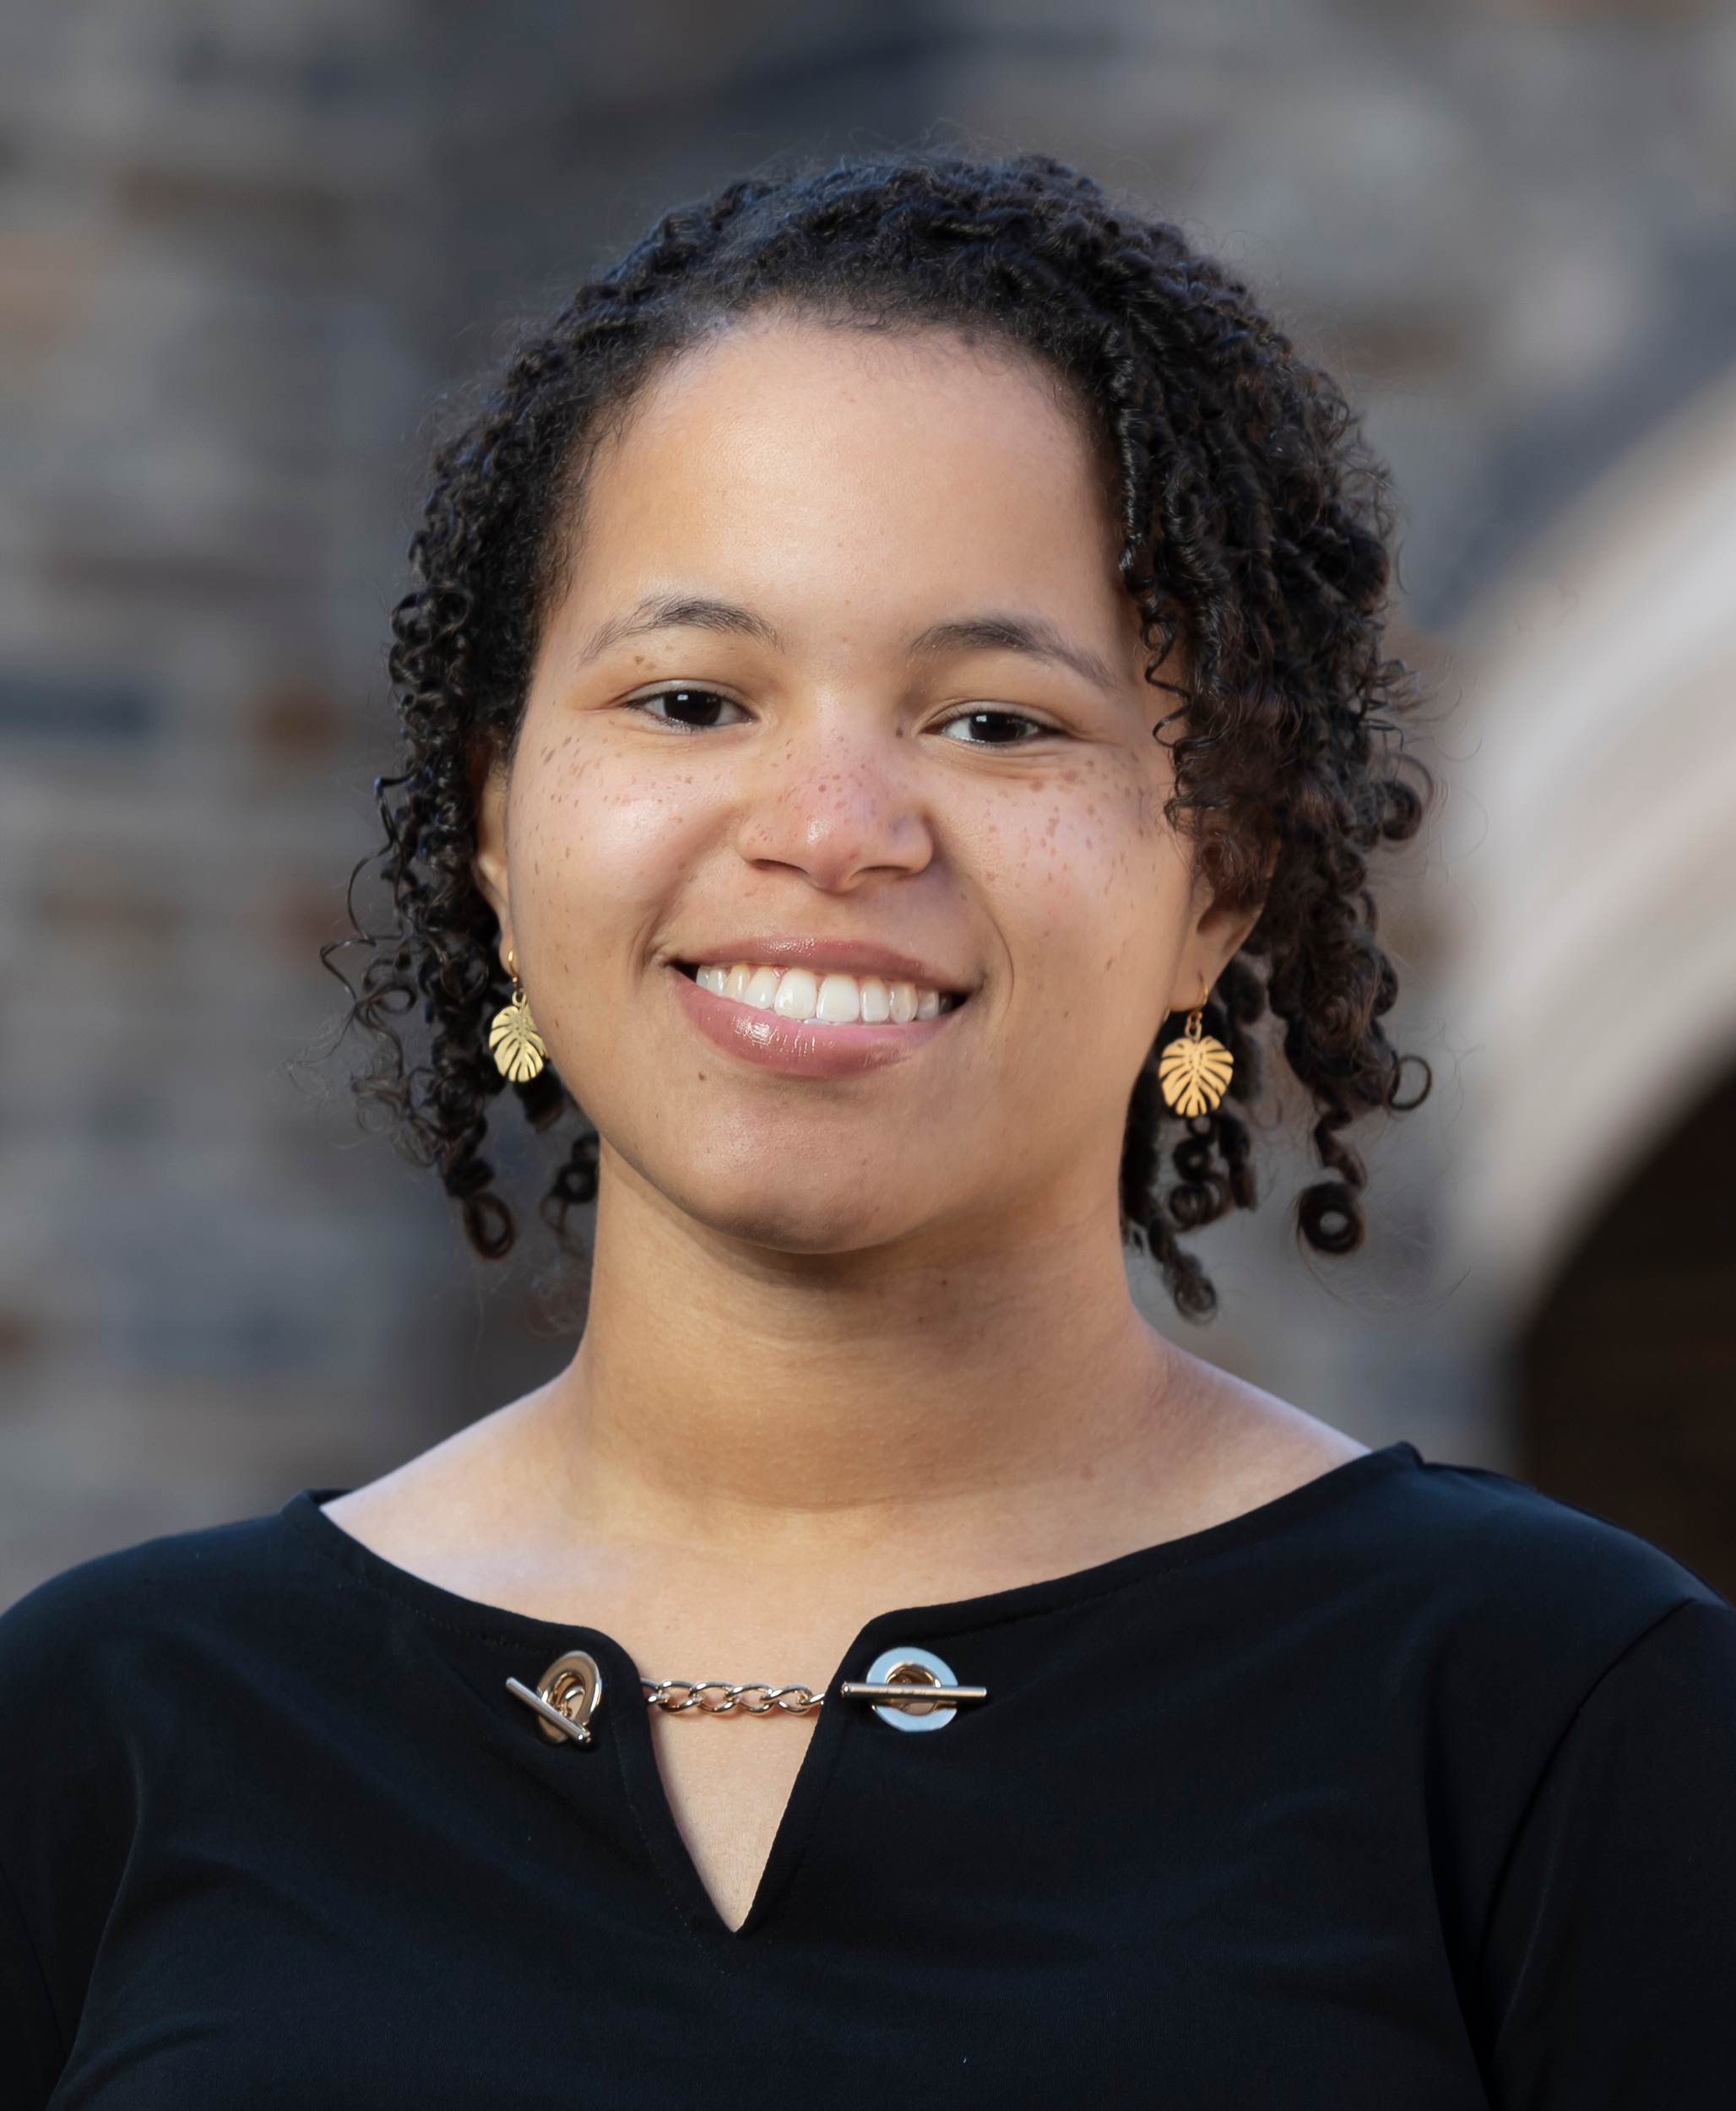
Clustering
(Genetic Networks)
Guest Lecturer: Dr. Brandie Quarles-Chidyagwai (Dr. QC)
Postdoctoral Scholar
Maloof and Gremer Labs
Notes:
Welcome to this video lecture on genetic networks. Over the next couple of labs you are going to build genetic networks starting with clustering techniques
Introduce myself

Slide 2
Learning Objectives
Define
Define clustering as an alternative to differential gene expression analysis
Identify
Identify the differences between clustering methods
Explain
Explain how the gap-statistic can address one of the limitations to k-means clustering
Notes:
By the end of this lecture you should be able to…

Slide 3
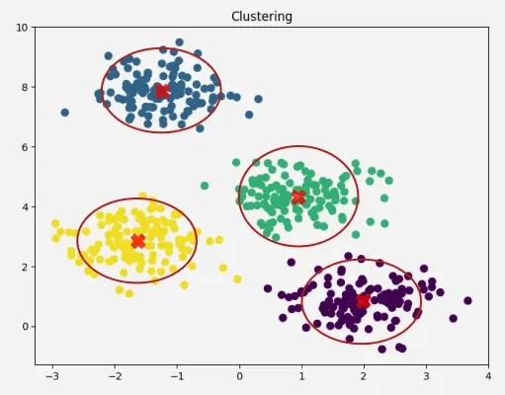
What is Clustering?
Alternative to doing differential gene expression analysis
Look for patterns in RNAseq data
  Especially useful as the data sets get larger
https://www.geeksforgeeks.org/machine-learning/clustering-in-machine-learning/
Notes:
In the last set of labs you learned how to find genes that were differentially expressed using stats.
Through that method you essentially went gene by gene to come up with a list of genes that were diff b/t treatments and genotypes
An alternative is clustering
The 12 samples your worked with last week are part of a much larger data set. Starting this lab, you will work with 57 samples from the same experiment.
plot gene expression values of genes of interest

Slide 4
Goals of Clustering
Identify groups (or clusters) of samples with similar expression patterns (why?)
Identify groups (or clusters) of genes with similar expression patterns (why?)
Notes:
Clusters can be samples (i.e. different treatments like sun vs. shade and different genotypes)
Which conditions are biologically more similar
Molecular diagnostics (samples from cancerous and benign tumors – differentiate benign vs malignant and diff classes of tumors)
Clusters can also be genes (i.e. genes involved in photosynthesis, genes involved in transpiration)
Many genes don’t have good annotation → clustering = guilty by association (may work in similar processes as the genes with known function that they cluster with)
Similar to GO analysis can find networks or groups of genes that function together → if those are a large portion of DEGs, can guide toward biological diffs among samples

Slide 5
Clustering Methods
Hierarchical clustering (today)
K-means clustering (today)
Co-expression (next lab)
Notes:
Co-expression = Correlation in expression

Slide 6
Hierarchical Clustering
Basic steps:
Calculate distances between each pair of samples (or genes)
Pair the closest samples together
Recalculate distances
Pair the closest samples
Repeat 3 and 4
Notes:
Type of distance depends on dataset
RNAseq – how similar the expression patterns are
Repeat until no more pairs
https://www.geeksforgeeks.org/machine-learning/hierarchical-clustering/

Slide 7
Step 1: Calculate Distances
 | Davis | Sac | Yose | Truck | LA
Davis | 0
Sac |  | 0
Yose |  |  | 0
Truck |  |  |  | 0
LA |  |  |  |  | 0
City (in CA) | Mean Annual Precip. (2006-2020)
Davis | 18.86 inches
Sacramento | 16.94 inches
Yosemite | 30.19 inches
Truckee | 27.98 inches
Los Angeles | 11.39 inches
Data from NOAA
Notes:
Step 1: Calculate distances between each pair of samples (or genes)
Q: FILL OUT THE FIRST ROW OF THE DISTANCE MATRIX
https://www.ncei.noaa.gov/access/us-climate-normals/#dataset=normals-annualseasonal&timeframe=15&location=CA&station=USC00042294

Slide 8
Step 2: Pair the Closest Samples
 | Davis | Sac | Yose | Truck | LA
Davis | 0 | 1.92 | 11.33 | 9.12 | 7.47
Sac | 1.92 | 0 | 13.25 | 11.04 | 5.55
Yose | 11.33 | 13.25 | 0 | 2.21 | 18.8
Truck | 9.12 | 11.04 | 2.21 | 0 | 16.59
LA | 7.47 | 5.55 | 18.8 | 16.59 | 0
City (in CA) | Mean Annual Precip. (2006-2020)
Davis | 18.86 inches
Sacramento | 16.94 inches
Yosemite | 30.19 inches
Truckee | 27.98 inches
Los Angeles | 11.39 inches
Data from NOAA
Notes:
Step 2: Pair the closest samples together
Q: WHICH TWO CITIES SHOULD WE PAIR FIRST
https://www.ncei.noaa.gov/access/us-climate-normals/#dataset=normals-annualseasonal&timeframe=15&location=CA&station=USC00042294

Slide 9
Step 3: Recalculate distances
After merging to create a cluster, re-compute distances from the new node to all other nodes
 | Davis_Sac | Yose | Truck | LA
Davis_Sac | 0 | NA | NA | NA
Yose | NA | 0 | 2.21 | 18.8
Truck | NA | 2.21 | 0 | 16.59
LA | NA | 18.8 | 16.59 | 0
 | Davis | Sac | Yose | Truck | LA
Davis | 0 | 1.92 | 11.33 | 9.12 | 7.47
Sac | 1.92 | 0 | 13.25 | 11.04 | 5.55
Yose | 11.33 | 13.25 | 0 | 2.21 | 18.8
Truck | 9.12 | 11.04 | 2.21 | 0 | 16.59
LA | 7.47 | 5.55 | 18.8 | 16.59 | 0
What distance value to use?
Could use minimum, maximum, or average distance.
The default in r hclust is maximum

Slide 10
Step 3: Recalculate distances
After merging to create a cluster, re-compute distances from the new node to all other nodes
 | Davis_Sac | Yose | Truck | LA
Davis_Sac | 0 | 13.25 | 11.04 | 7.47
Yose | 13.25 | 0 | 2.21 | 18.8
Truck | 11.04 | 2.21 | 0 | 16.59
LA | 7.47 | 18.8 | 16.59 | 0
 | Davis | Sac | Yose | Truck | LA
Davis | 0 | 1.92 | 11.33 | 9.12 | 7.47
Sac | 1.92 | 0 | 13.25 | 11.04 | 5.55
Yose | 11.33 | 13.25 | 0 | 2.21 | 18.8
Truck | 9.12 | 11.04 | 2.21 | 0 | 16.59
LA | 7.47 | 5.55 | 18.8 | 16.59 | 0
What distance value to use?
Could use minimum, maximum, or average distance.
The default in r hclust is maximum

Slide 11
Pair and Recalculate Distances… Repeat
 | Davis_Sac | Yose | Truck | LA
Davis_Sac | 0 | 13.25 | 11.04 | 7.47
Yose | 13.25 | 0 | 2.21 | 18.8
Truck | 11.04 | 2.21 | 0 | 16.59
LA | 7.47 | 18.8 | 16.59 | 0
 | Davis_Sac | Yose_Truck | LA
Davis_Sac | 0 | 13.25 | 7.47
Yose_Truck | 13.25 | 0 | 18.8
LA | 7.47 | 18.8 | 0

Slide 12
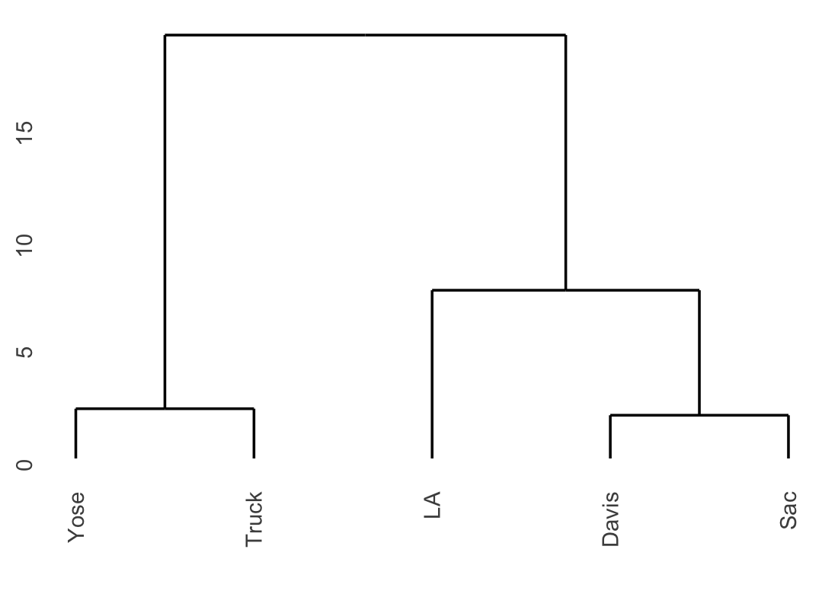
Dendrograms
Visual Representation of Hierarchical Clustering
Family tree of clusters
Bottom = each data point as its own group
As you move up, similar groups are combined
The shorter the line, the more similar data points are
Notes:
Through this process you can build a tree called a dendrogram
Hierarchical b/c start from closest groups and work way out in a hierarchy of nodes

Slide 13
K-means Clustering
Basic steps:
Define the number of clusters desired
Randomly assign each gene to a cluster
Calculate the mean position of each cluster (aka cluster centroid)
Assign each gene to to the cluster whose centroid it is closest to
Repeat until stable
Notes:
https://www.geeksforgeeks.org/machine-learning/k-means-clustering-introduction/

Slide 14
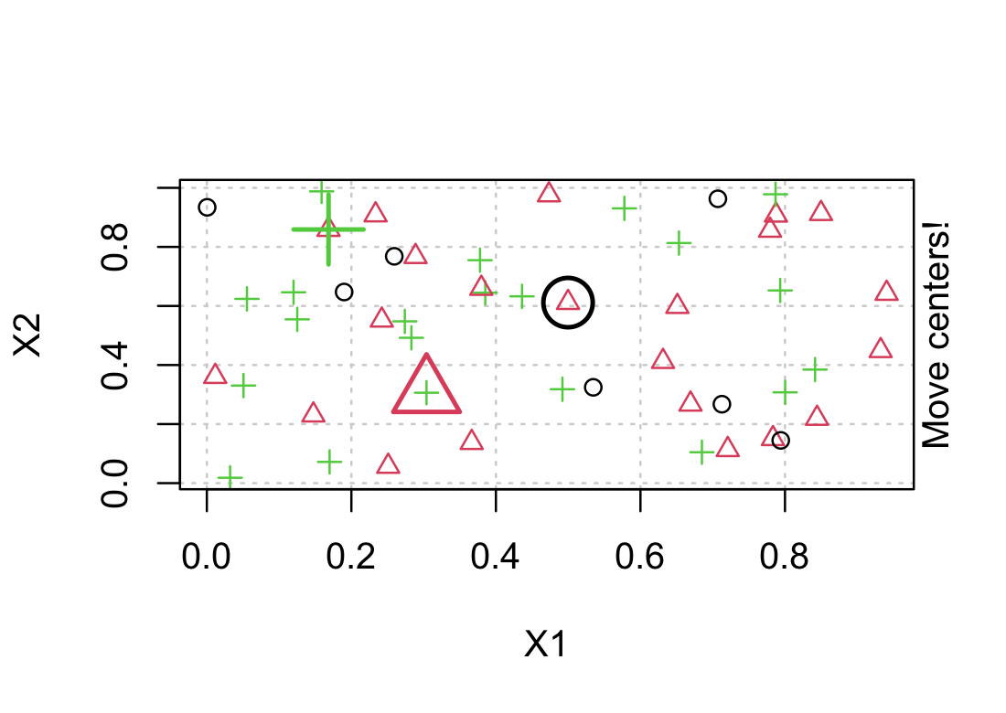
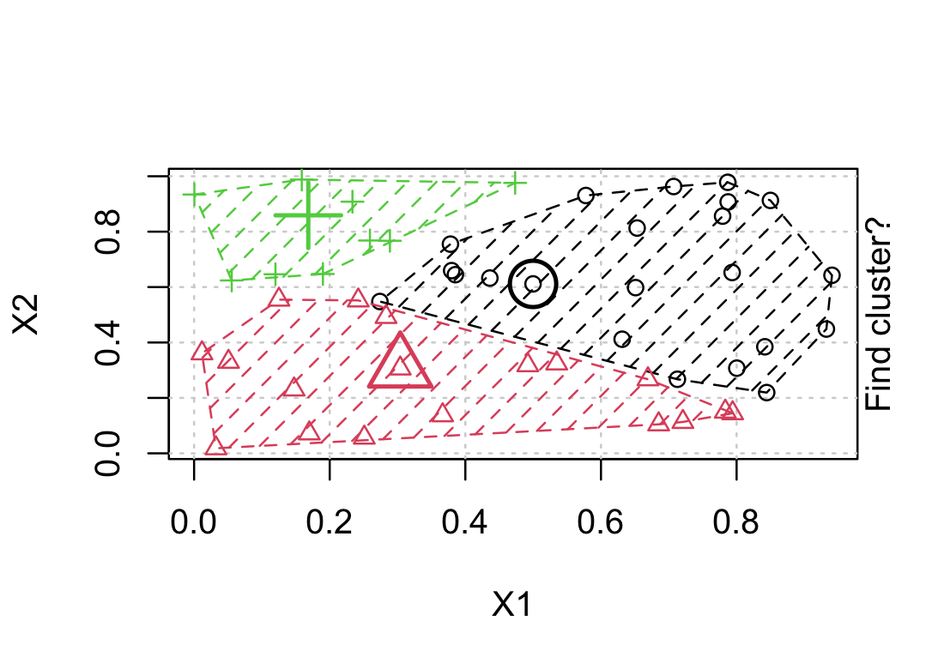
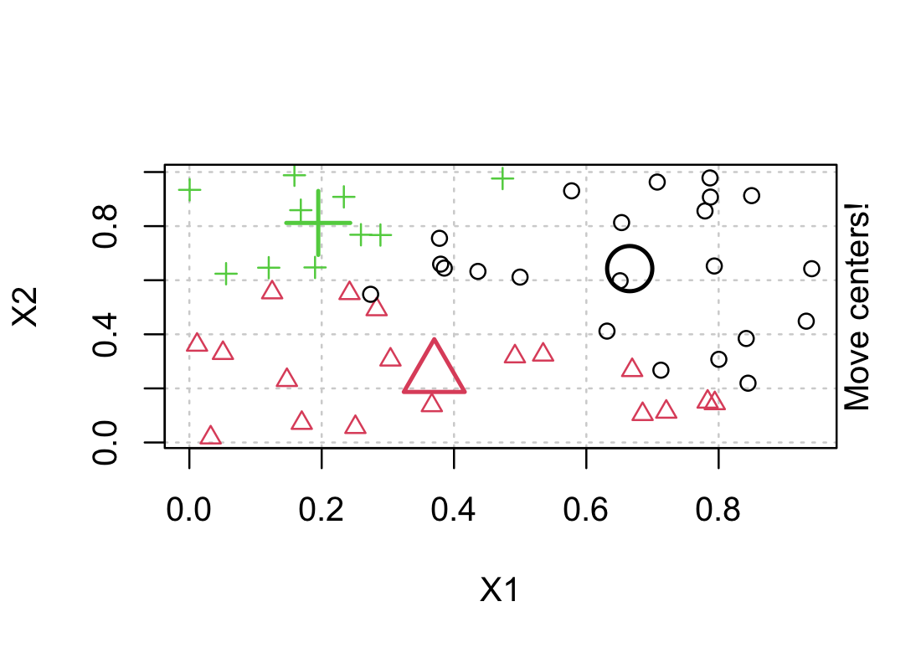
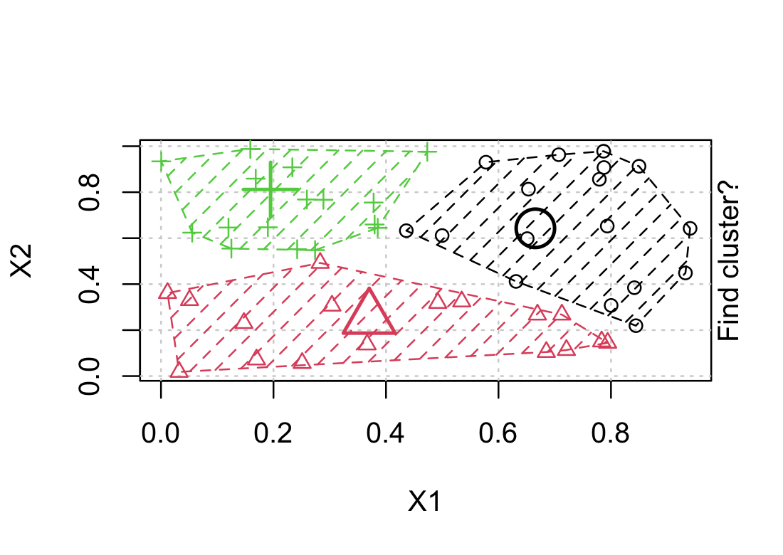
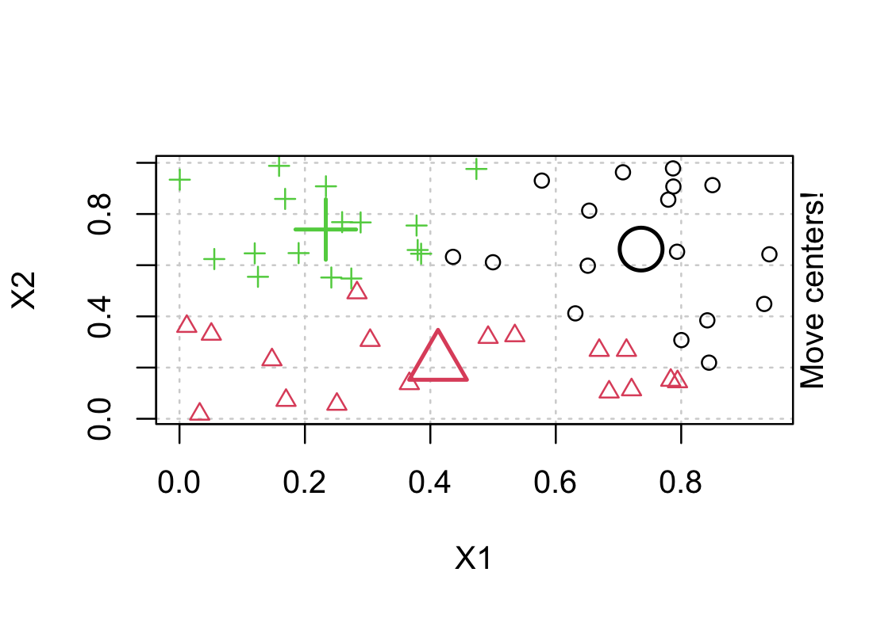
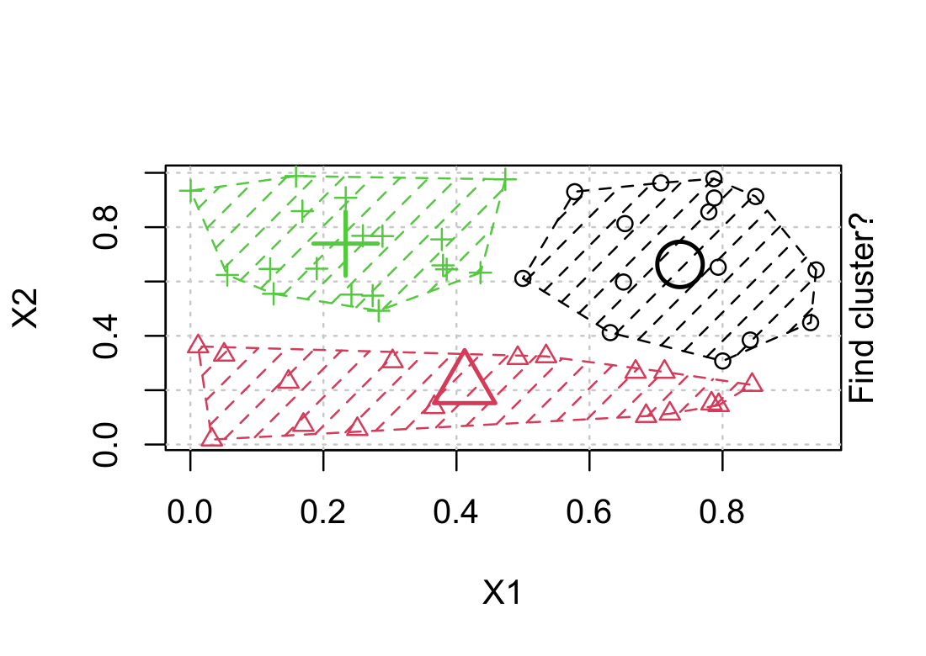

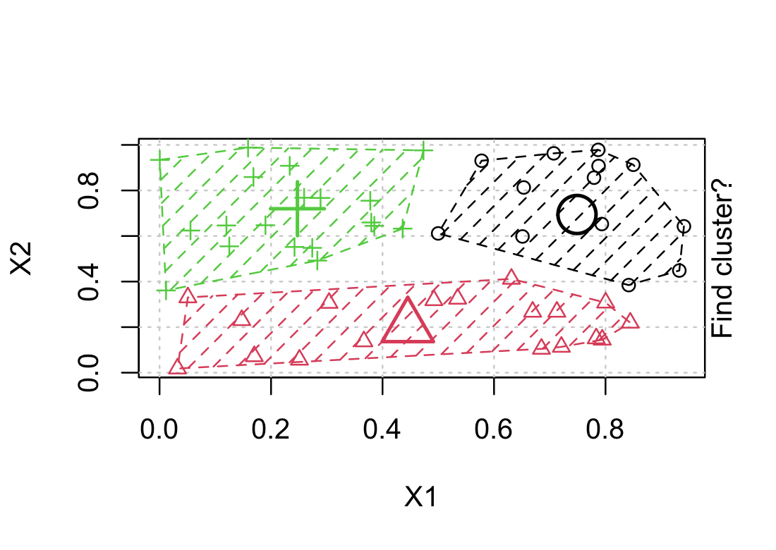
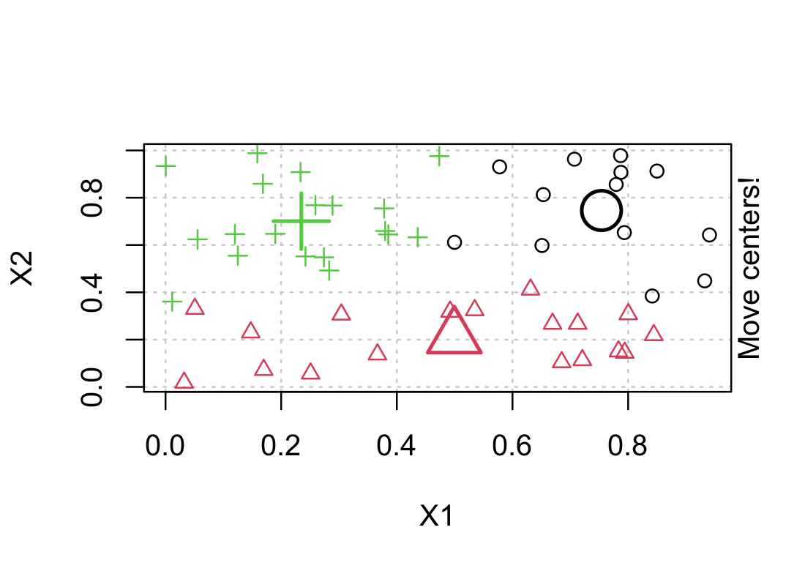
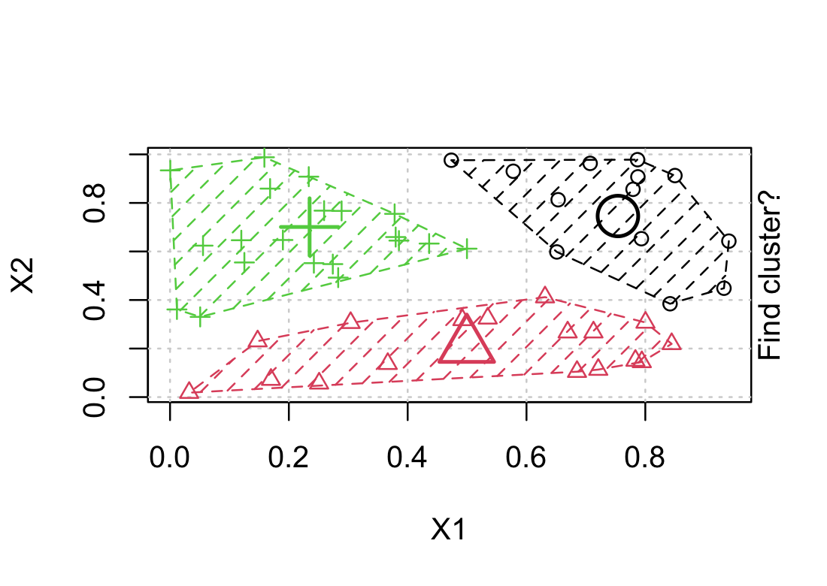
K-means Example (3 clusters)
Notes:
Each point = one sample or gene
Randomly assigned to one of 3 classes (triangle, circle, plus)
Randomly pick one point of each to be the cluster nucleator
Calc distance from each small point to each of the large points
Reassign membership based on distance
Calc mean pos of each cluster

Slide 15
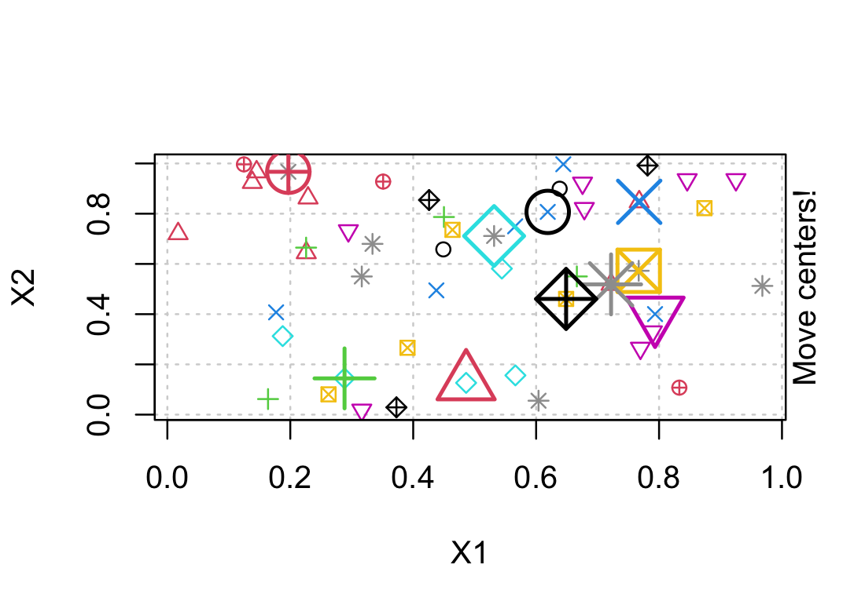
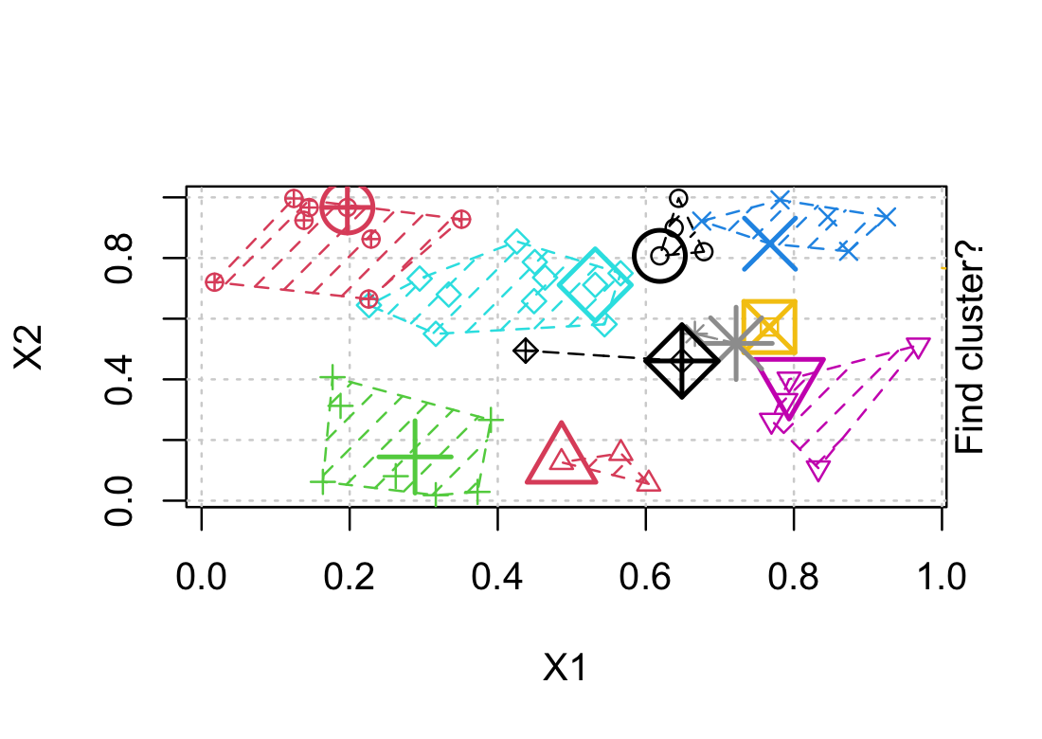
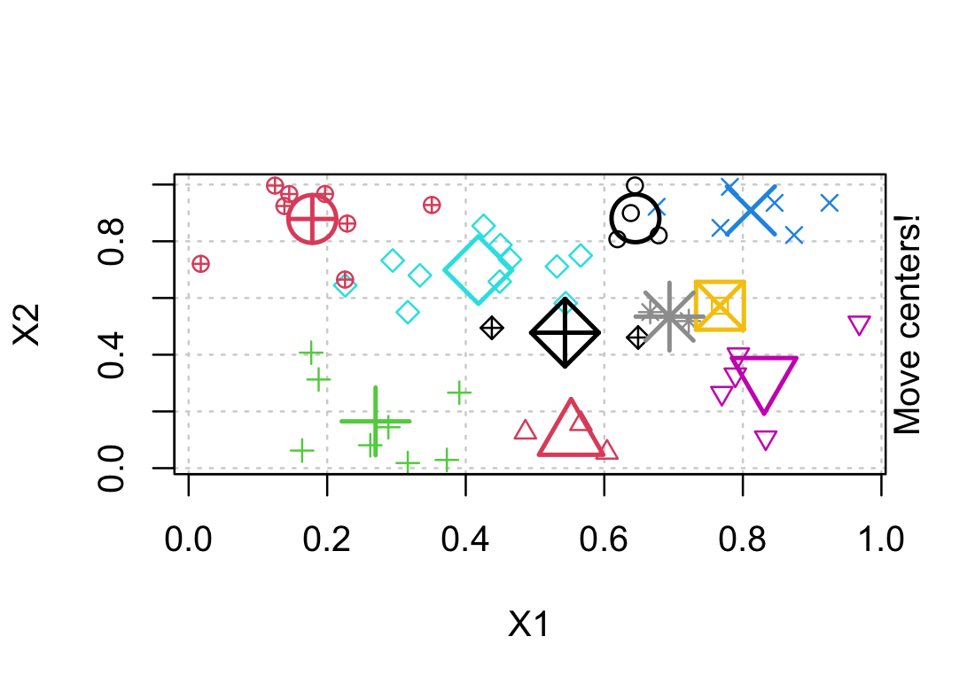
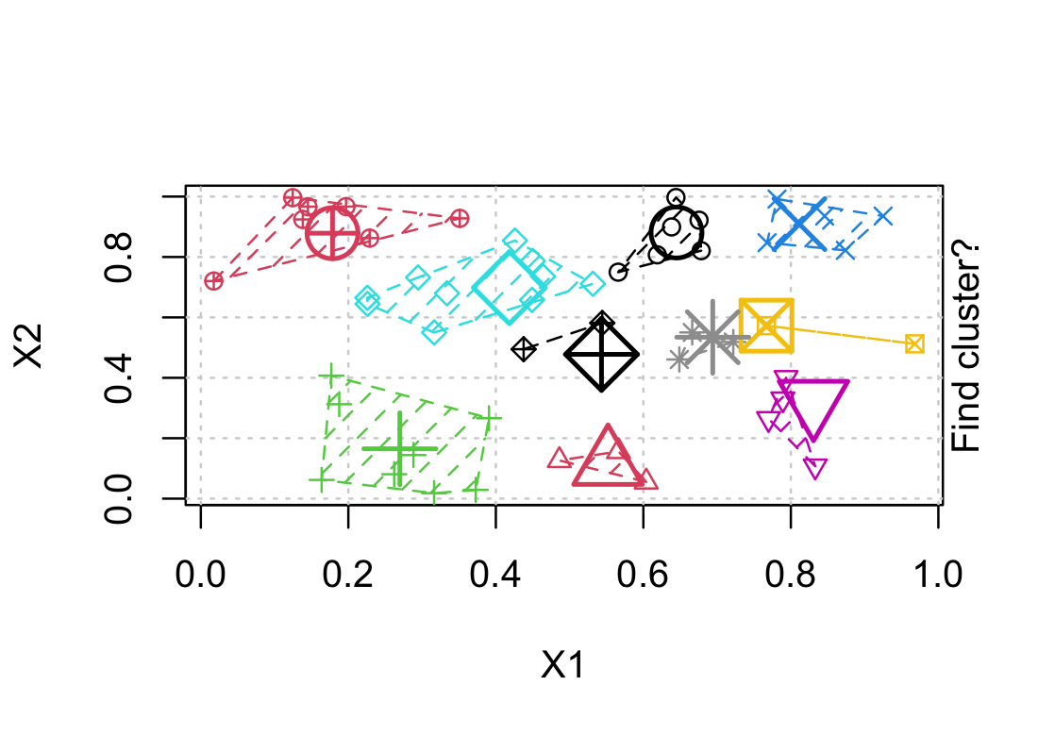
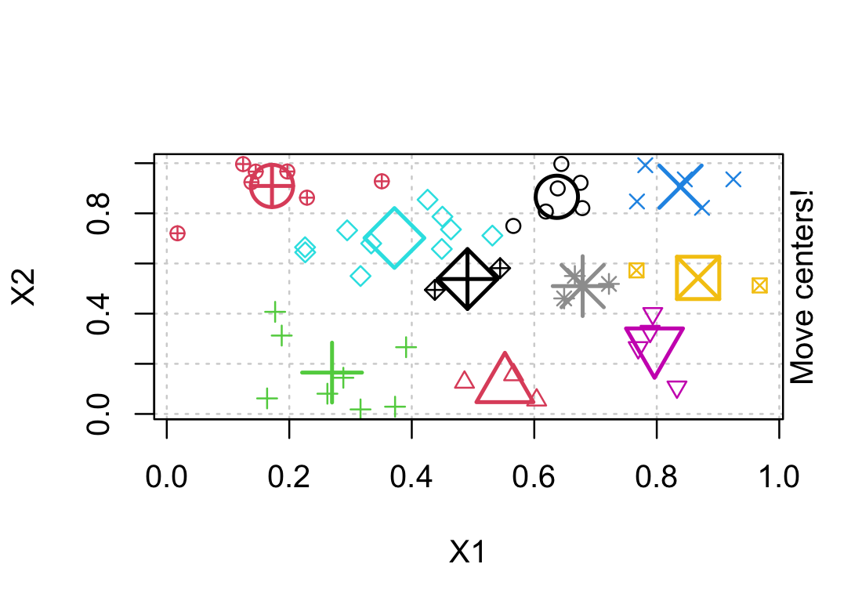
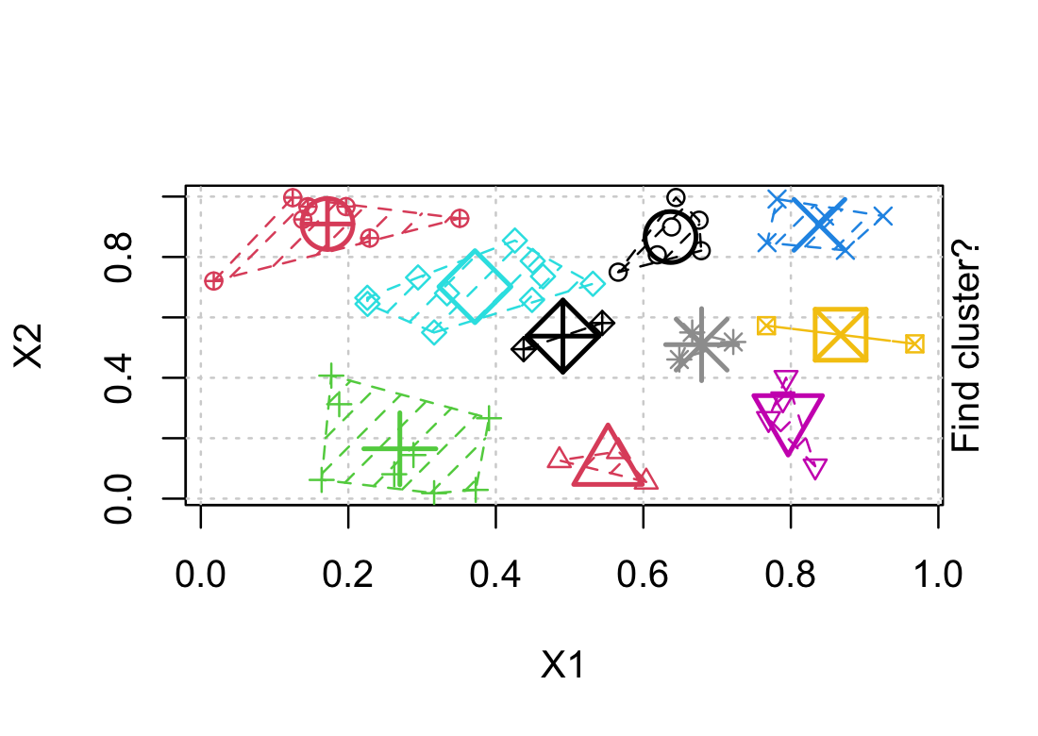
K-means Example (10 clusters)
Notes:
So how do you know how many clusters you should use?

Slide 16
Gap-statistic
How do you choose the number of clusters?
Cluster variance = average squared distance from cluster center to each member
Calculate within-cluster variance for N random clusters = “Expected Random”
Calculate within-cluster variance for K-means clusters = “Observed”
Choose the smallest number of clusters that maximizes the ”gap” between observed and expected random within-cluster variance
Notes:
Expected random should be large – no reason things will group together randomly
Should have smaller Observed variance if our clusters mean anything

Slide 17
Gap-statistic
How do you choose the number of clusters?
Cluster variance = average squared distance from cluster center to each member
Calculate within-cluster variance for N random clusters = “Expected Random”
Calculate within-cluster variance for K-means clusters = “Observed”
Choose the smallest number of clusters that maximizes the ”gap” between observed and expected random within-cluster variance
Notes:
Gap stat increases up to a point and then plateaus
- Want the smallest # of clusters where we reach that plateau

Slide 18
Key Concepts
Clustering looks for patterns in gene expression data
  Especially helpful with large data sets
  Can cluster by samples or genes
Hierarchical clustering starts with closest pair
K means clustering starts with k number of clusters
Gap statistic can identify the ideal number of clusters
Notes:
Hierarchical clustering starts with closest pair and then works its way up to build a tree depicting relationships based on paired distances
K means clustering starts with k number of clusters and iteratively assigns data points to the nearest centroid to minimize within-cluster sum of squares.
In lab you will work through these methods more and apply them to a larger RNAseq data set

