Slide 1
Announcements June 02
No AI lab
  Github copilot student accounts are still on hold
  I was not able to do what I wanted you to do with free tier
I did update the lab to use more modern tools relative to previous years
  Will require some new installs
Cut and paste code in the lab

Slide 2
Reminder: DP and NDP
This lab is still working with the Dense Planting (DP) and Non-Dense-Planting (NDP) data sets
In the DP treatment we expect
  Plants to elongate more as they try to compete with their neighbors for light.
    Cell wall, lignin, plant hormones
  Plant roots to be competing for more resources in the soil
    Root growth, cell wall, lignin, suberin
    Nutrient uptake and/or transport
      N, P, K, Fe
  Reduced plant defense (growth/defense tradeoff)

Slide 3
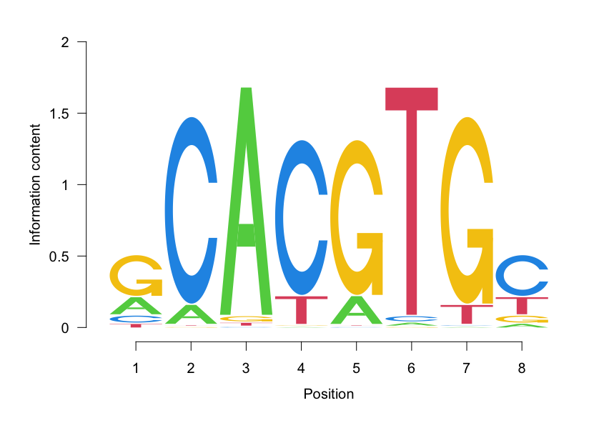
Binding site motifs and position weight matrices
  Transcription factors have are site-specific DNA binding proteins
  But they are a little promiscuous…do not have absolute sequence specificity
  For example, the Arabidopsis transcription factor MYC2 has an 8 base binding motif
  When we are searching for these motifs in gene promoters we need to take this promiscuity into account.
  This is done using a position weight matrix

Slide 4
Other stuff
Thursday lecture is live (no video)
Final will be similar format to Midterm, but in class portion comes after take home
In class midterm is in this room at the scheduled final exam time (Wednesday June 10, 3:30)
1 hour time limit on in class final
Study guide coming soon

