Slide 1
Sequence Homology Searches with BLAST
Julin Maloof
Some Slides courtesy of Venkatsean Sundaresan

Slide 2
The Scenario
Let’s role back the clock to December, 2019.

Slide 3
The Scenario
Let’s role back the clock to December, 2019.
A strange new respiratory illness is rapidly spreading.
Disease etiology suggests that it is caused by a virus.

Slide 4
The Scenario
Let’s role back the clock to December, 2019.
A strange new respiratory illness is rapidly spreading.
Disease etiology suggests that it is caused by a virus.
What kind of virus?
Your colleagues purify viruses from an infected patient and assemble 8 viral genome sequences.

Slide 5
The Scenario
Let’s role back the clock to December, 2019.
A strange new respiratory illness is rapidly spreading.
Disease etiology suggests that it is caused by a virus.
What kind of virus?
Your colleagues purify viruses from an infected patient and assemble 8 viral genome sequences.
Your tasks:
  Determine which of these 8 are the likely cause
  Determine the evolutionary origin of the new virus

Slide 6
Methods
Your tasks:
  Determine which of these 8 are the likely cause
  Determine the evolutionary origin of the new virus
How?
  Search for homologous sequences in a database of sequenced viral genomes
  Build a phylogenetic tree of related sequences

Slide 7


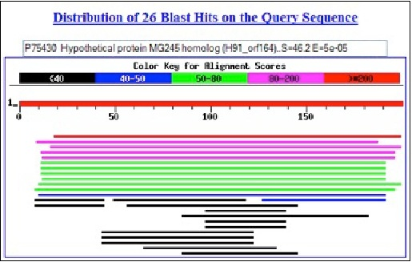
BLAST
(Basic Local Alignment Search Tool)
QUERY sequence(s)
BLAST results
BLAST program
BLAST
database
• Search for similarity to infer “homology”

Slide 8
BLAST
BLAST is optimized to search large databases quickly.
How does it do this?

Slide 9
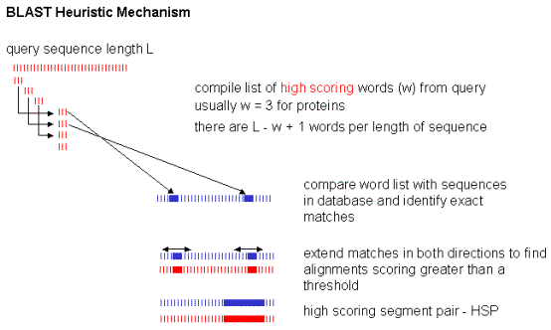
BLAST: Heuristic algorithm
Query sequence of length L (this is the sequence with which you do a search)
Compile list of words (w) from query
usually w=3 for proteins and 11-28 for nucleotides
There are L-w+1 words in sequence L
Begin with high scoring words
Galisson EMBER (2000)

Slide 10
BLAST: Heuristic algorithm
Query sequence of length L (this is the sequence with which you do a search)
Compile list of words (w) from query
usually w=3 for proteins and 11-28 for nucleotides
There are L-w+1 words in sequence L
Begin with high scoring words
Compare word list with sequences in database and identify matches
Galisson EMBER (2000)

Slide 11
BLAST: Heuristic algorithm
Query sequence of length L (this is the sequence with which you do a search)
Compile list of words (w) from query
usually w=3 for proteins and 11-28 for nucleotides
There are L-w+1 words in sequence L
Begin with high scoring words
Compare word list with sequences in database and identify matches
Extend matches in both directions until further extension causes the score to drop by a certain amount
Galisson EMBER (2000)

Slide 12
BLAST: Heuristic algorithm
Query sequence of length L (this is the sequence with which you do a search)
Compile list of words (w) from query
usually w=3 for proteins and 11-28 for nucleotides
There are L-w+1 words in sequence L
Begin with high scoring words
Compare word list with sequences in database and identify matches
Extend matches in both directions until further extension causes the score to drop by a certain amount
High scoring segment pair HSP
Galisson EMBER (2000)

Slide 13
A scoring matrix is used to evaluate matches
Numbers represent the probability of finding that sequence pair in homology sequences

Slide 14
A scoring matrix is used to evaluate matches
Numbers represent the probability of finding that sequence pair in homology sequences
S1: W-A-S-P
S2: W-E-S-T
W-W = 11
A-E = -1
S-S = 4
P-T = -1
Total score for this alignment: 13

Slide 15
Q :ROBJOEZACANNLIZ
Break this up into 3 letter words
ROB,OBJ,BJO,..,ZAC,…ANN,…NLI,LIZ

Slide 16
Q :ROBJOEZACANNLIZ
Break this up into 3 letter words
ROB,OBJ,BJO,..,ZAC,…ANN,…NLI,LIZ
Search sequences S1, S2, etc. in database
Find a match with the word ZAC then extend on both sides until no or weak matches

Slide 17
Q :ROBJOEZACANNLIZ
Break this up into 3 letter words
ROB,OBJ,BJO,..,ZAC,…ANN,…NLI,LIZ
Search sequences S1, S2, etc. in database
Find a match with the word ZAC then extend on both sides until no or weak matches
Q :ROBJOEZACANNLIZ
S1:TOMZOEZACANNLIA
Q :ROBJOEZACANNLIZ
S2:TOMZOEZACAMYLEA

Slide 18
Q :ROBJOEZACANNLIZ
Break this up into 3 letter words
ROB,OBJ,BJO,..,ZAC,…ANN,…NLI,LIZ
Search sequences S1, S2, etc. in database
Find a match with the word ZAC then extend on both sides until no or weak matches
Q :ROBJOEZACANNLIZ
S1:TOMZOEZACANNLIA
Q :ROBJOEZACANNLIZ
S2:TOMZOEZACAMYLEA

Slide 19
Search with high scoring words first for better chance of high scoring alignments
Q:LVAAVGVCWDILRAAA
In the above example, BLOSUM62 scores for matches to LVA and CWD are 12 and 26 respectively, so search with CWD
Q:LVAAVGVCWDILRAAA
|| |||||| |
S:AGGAVVVCWDILKAGG

Slide 20
useful parameters
Word size: the size of the chunks that the query sequence is chopped into
Threshold: minimum score for a word match to be considered to seed an extension

Slide 21
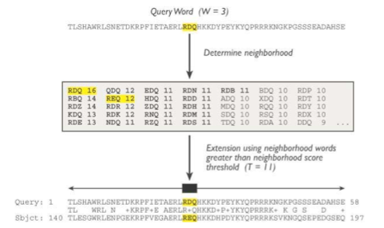
How BLAST works
Seed using neighborhood words greater than neighborhood score threshold (T=11)
HSP = High-scoring Segment Pair – a segment pair whose score will not increase by further extension or by trimming
Score (S) = measures alignment quality (scoring matrix - gaps)
E value (E) = number of different alignments with score S that are expected to occur by chance in a search of that database

Slide 22
Nucleotide vs Protein BLAST
blastn: nucleotide blast. Comes in different flavors
  megablast: optimized for nearly identical sequences
  dc-megablast: discontinuous megablast…more distant sequences

Slide 23
Nucleotide vs Protein BLAST
blastn: nucleotide blast. Comes in different flavors
  megablast: optimized for nearly identical sequences
  dc-megablast: discontinuous megablast…more distant sequences
Seeding:
  Default word size is 28 (megablast) or 11 (dc-megablast)
  No threshold for seeding, requires exact match

Slide 24
Nucleotide vs Protein BLAST
blastn: nucleotide blast. Comes in different flavors
  megablast: optimized for nearly identical sequences
  dc-megablast: discontinuous megablast…more distant sequences
Seeding:
  Default word size is 28 (megablast) or 11 (dc-megablast)
  No threshold for seeding, requires exact match
Scoring matrix
  Exact match: +1 (megablast); +2 (dc-megablast)
  Any mismatch: -2 (megablast); -3 (dc-megablast)

Slide 25
BLAST Summary
Computes regions of high “similarity” in local alignments of 2 sequences
Break search into “chunks” by finding all subsequences (stretches of similarity, or “words”) of length k that occur in both seqs
Build score on matches (scoring matrix, gap cost)
Extend subsequences to see if score increases
Compute total score (when no more extensions are possible)
Then compare BLAST score against precomputed expected scores for all sequences in database
Then rank score

Slide 26
Command Line BLAST
You are probably familiar with the web interface for BLAST
We will use a command-line version of the program
Why would one want to do this?
  Overcome web version limitations on query size
    E.g. BLAST one genome against another
  Can use custom database
  Easier to test the effect of changing parameters
  Torture

