Slide 1
BIS180L
Rice Diversity Lab
Professor MALOOF

Slide 2
Outline
Part I:
  Lecture
    Intro to rice
    Review of population structure
    MDS and PCA plots
  Lab
    Analyze rice phenotypic and genetic diversity
    New R Skills
      Reformatting data tables from wide to long format (and back)
      Joining data frames with different columns
      Plotting with ggplot
Part II (Following lab period)
  Lecture and Lab:
    Genome Wide Association Mapping

Slide 3
First: Sensitivity and Specificity
Sensitivity: How likely you are to find a sequence.
  Increased sensitivity = more sequences detected.
  But there may be more noise (things that you don’t want).
  Like a microphone: if you have a very sensitive microphone you will detect more sounds but this will include more background.
  In BLAST, sensitivity comes at the expense of speed
Specificity: How specific are the results to your query?
  Increased specificity = fewer distant or unrelated sequences
Word size
  Small word size increases sensitivity.
    Why? BLAST searches start when a word from the query matches the subject. Smaller words are more likely to match
  Small word size slows down the search (more initial hits)
  Large word size decreases sensitivity
    A large word is less likely to find a match.

Slide 4
Assignment Dos and Don’ts
DO
  Look at your formatted html to make sure it is nicely formatted and tables are correct
  Include code so that we can troubleshoot and give partial credit
  Make sure code is in code blocks
  Comment out R code that downloads files or installs packages (or use eval=FALSE in the chunk option)
  Load libraries at beginning of file
  Questions and Answers should be on separate line
DON’T (you will lose points)
  Rename the template files
  Turn in poorly formatted work.
  Display extremely long tables

Slide 5
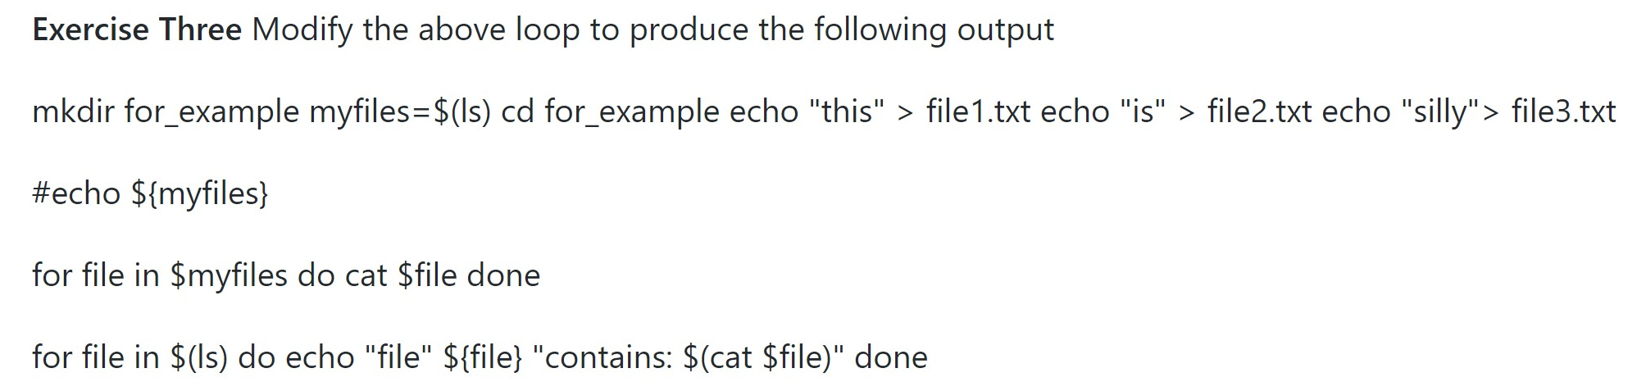
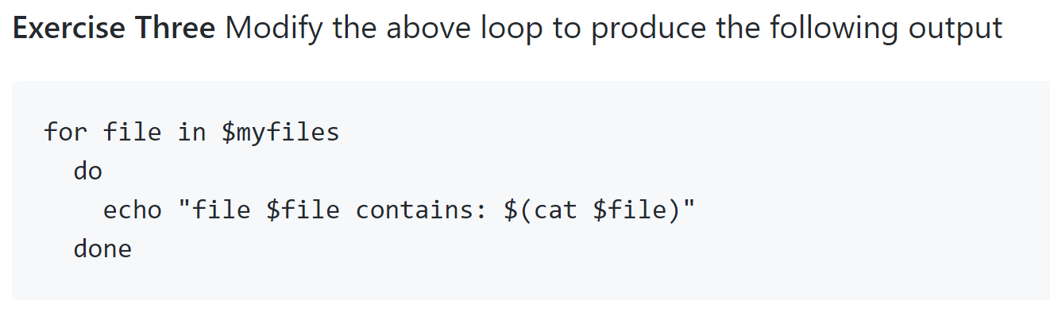
Bad (top) vs Good (bottom)

Slide 6
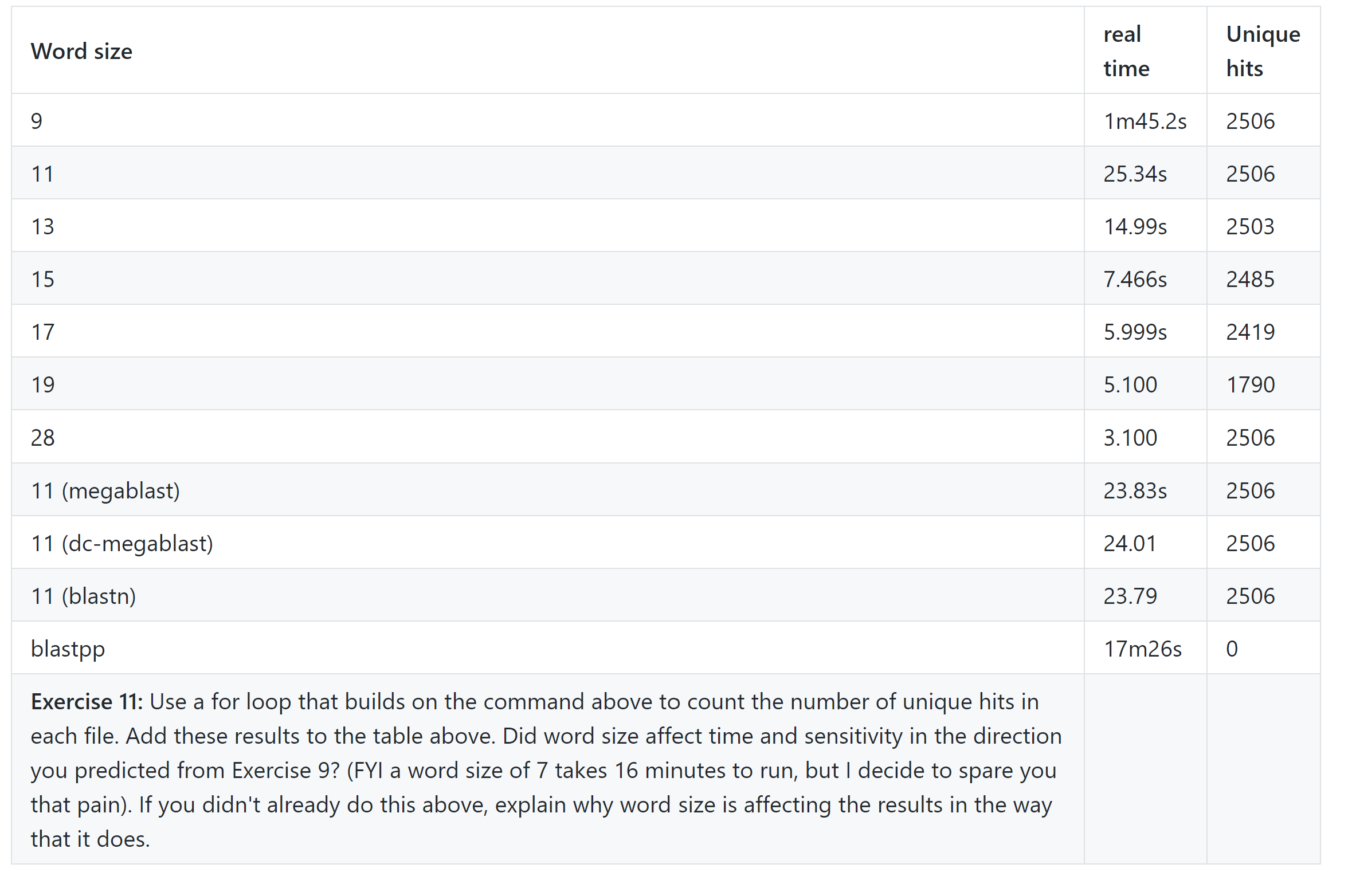
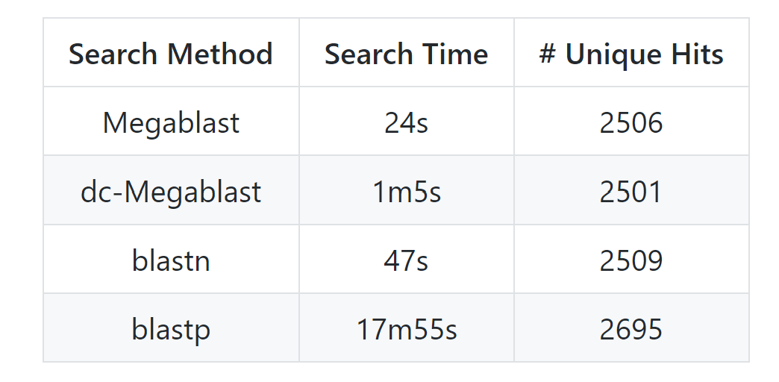
Bad (top) vs Good (bottom)

Slide 7
Bad

Slide 8
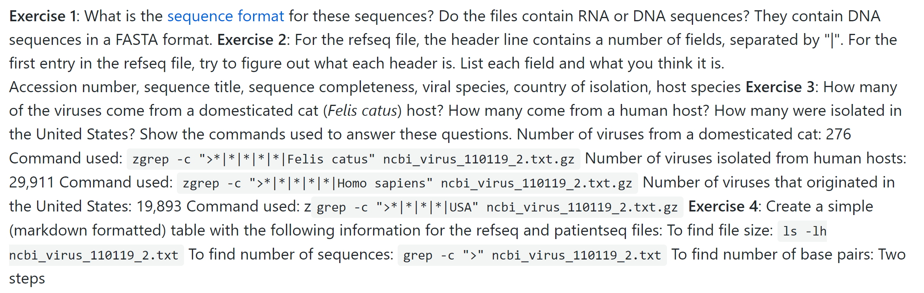
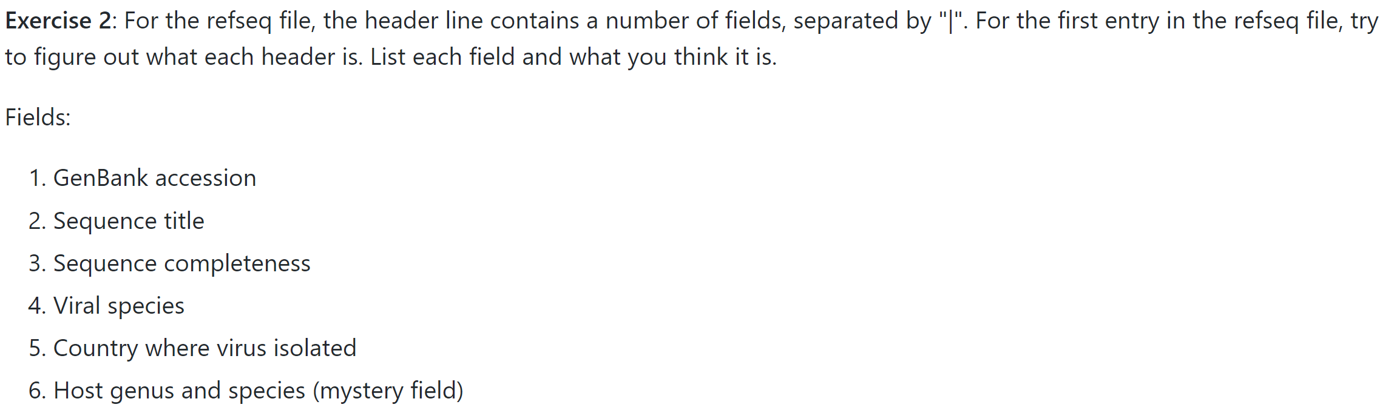
Very Bad (top) vs Good (bottom)

Slide 9
Study system: Rice
This Week:
  Study diversity in ~ 400 rice strains
Why Rice?

Slide 10
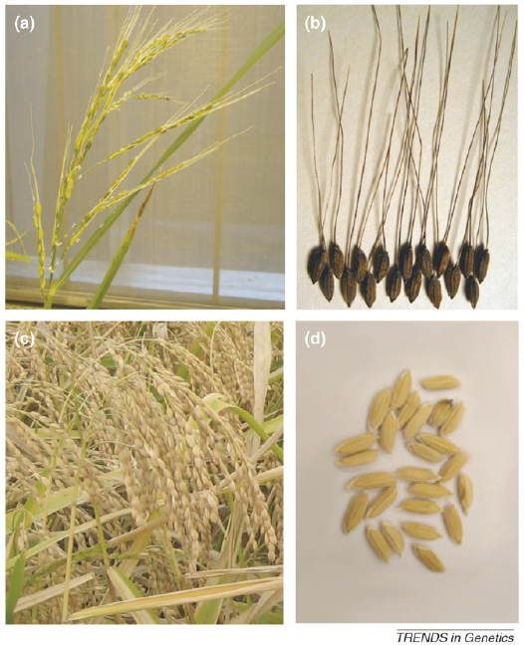
Rice Domestication
Rice progenitor:
Oryza rufipogon
Domesticated rice
Oryza sativa
Kovak et al, Trends in Genetics, 2007

Slide 11
Rice Diversity
Two main sub populations: Indica and Japonica
  Thought to have been domesticated independently from rufipogon
  Estimated divergence time: 100,000 years ago or more.
Indica
  Grown in lowland tropical areas
  S. and S.E. Asia and China
  Further subdivided into indica and aus
Japonica
  Grown in lowland and high-elevation upland areas of tropical SE Asia
  Also grown in colder temperate climates including NE Asia, Europe, Western US. Chile, Australia
  Subdivided into tropical japonica, temperate japonica, and aromatic

Slide 12
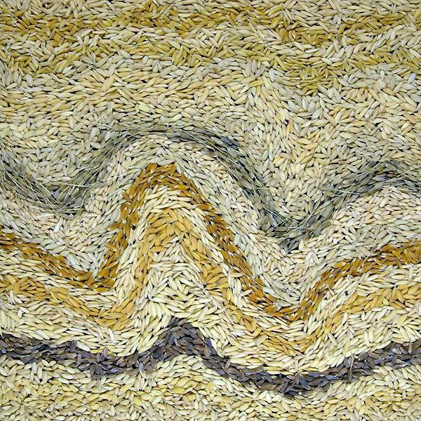
Using natural variation for rice improvement
Urgent need for crop improvement:
  World population expected to grow to 9,000,000,000 by 2050
  Climate change and increasing unpredictability will reduce yield
  Increasing demand for meat and biofuels put further strains on agriculture
One path forward is to use the natural genetic diversity (“natural variation”) already present in rice
  120,000 different rice strains have been deposited in seed banks
  These harbor different genetic variants
    Many are just random
    some provide adaptation to specific environments/stresses
      drought, flooding, heat, pathogens, etc
    some determine specific grain characteristics of consumer interest
      stickiness
      grain length
      aromatic (basmati, jasmine)
      color
Identify genes or genomic locations of variants
  Why?
Science Daily and IRRI
http://www.sciencedaily.com/releases/2009/07/090723113512.htm

Slide 13
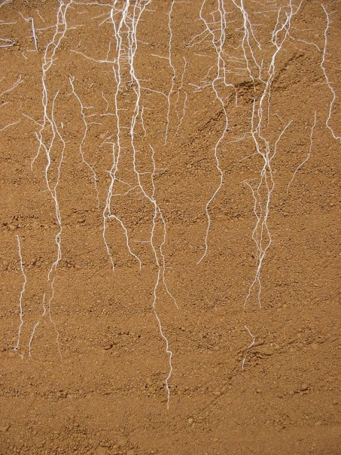
We will focus on root traits
Why Roots?
EU Root/Adam Price. http://www.euroot.eu/gallery/album1/

Slide 14
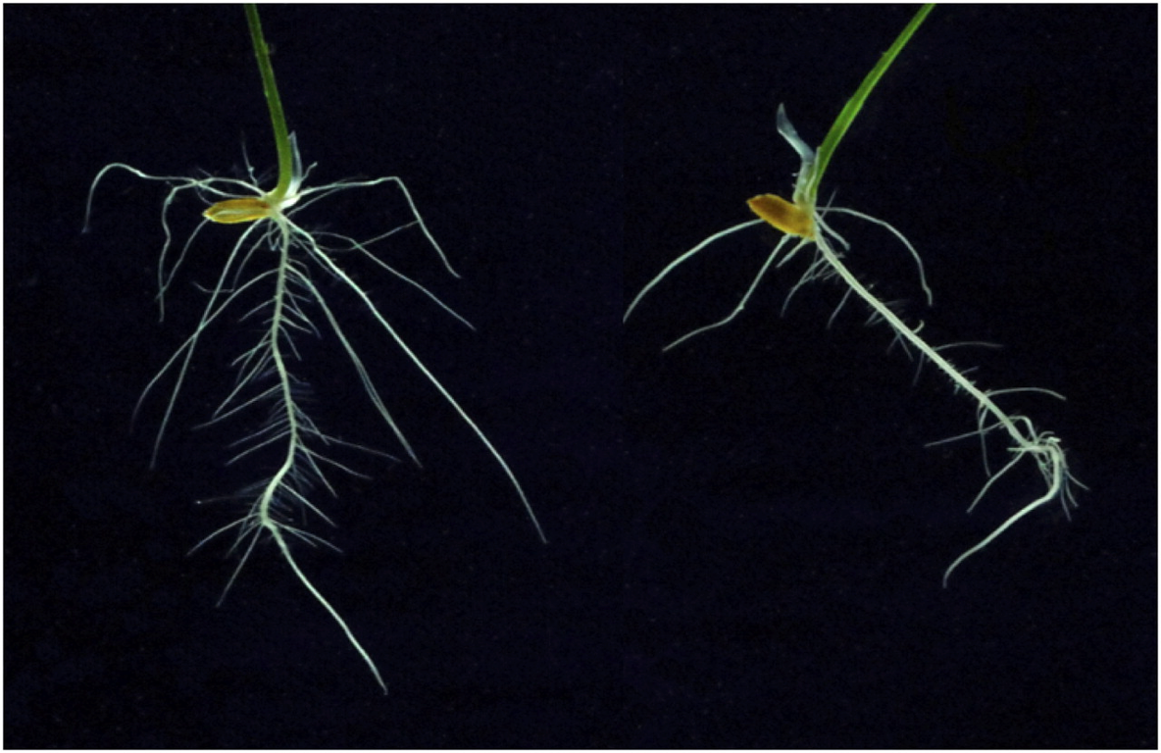
Root Aluminum Tolerance
Aluminum: Most abundant metal in earth’s crust.
Solubilized under highly acidic soil conditions
Toxic to plant roots
Can we find variation in resistance to Aluminum among rice varieties?
Control: no Al
+ Al
Famosa et al, Plant Phys., 2011

Slide 15
Study Design
413 Rice varieties from 82 countries
Phenotypes:
  Roots in control and Al+ conditions
  Grain length
  Amylose content
  Flowering time
  ...
Genotypes:
  Sequence 20 strains, find common SNPs
  Design Affymetrix “SNP chip”
  Assay 44,000 Single Nucleotide Polymorphisms on each of the 413 varieties
  Yields ~ 1 SNP per 10kb

Slide 16
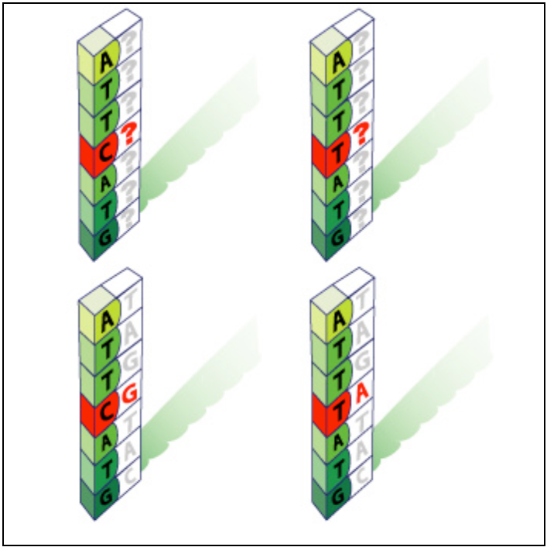
hybridization-based genotyping
Create probes that hybridize to the different SNP alleles.
Relies on better hybridization between DNA with a perfect match compared to a mismatch
Goal: genotype to determine ATTCATG vs ATTTATG

Slide 17
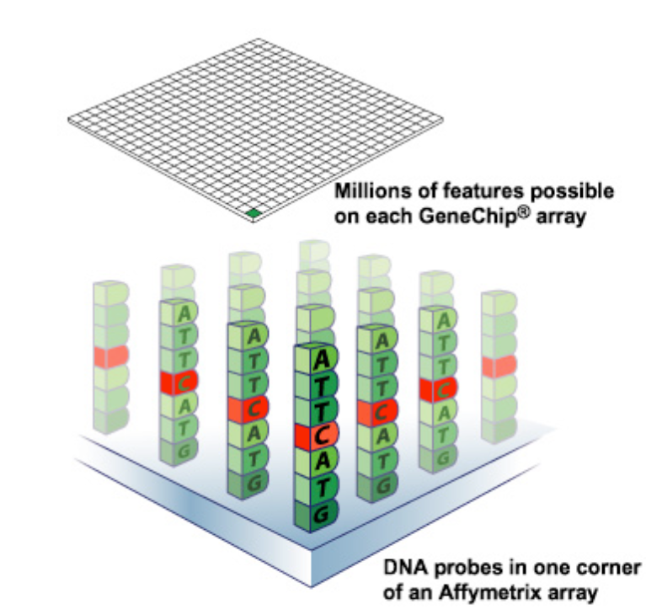
hybridization based genotyping
use a “chip” or microarray that has millions of different features.
each feature consists of many identical oligonucleotides (oligos)
millions of features =
  millions of SNPs that can be
  assayed at once.

Slide 18
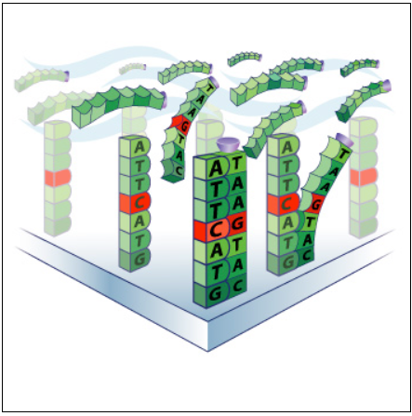
hybridization based genotyping
purify DNA from individual to be genotyped
  chop into small pieces
  label each piece with biotin
    (silver cup on slide)
  hybridize to chip

Slide 19
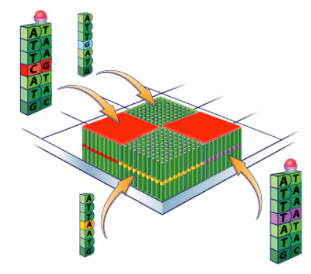
hybridization based genotyping
create a feature for each possible allele
labeled DNA will preferentially hybridize to the exact matches
add fluorescent-labeled streptavidin (binds to biotin)
  red ball in figure
scan chip to determine which
features have labeled DNA
What is the genotype of the
individual in this example?

Slide 20
Overview of Questions about Rice Data:
Population Structure:
  Are these samples from a single randomly mating population or are there sub-populations?
    Multi-Dimensional Scaling (MDS) or Principal components analysis (PCA)
    PSMix: Assign each individual to 1 of k populations
Can we find SNPs associated with Aluminum tolerance or other traits?
  What are the genes underlying these SNPs?

Slide 21
Overview of Questions about Rice Data:
Population Structure:
  Are these samples from a single randomly mating population or are there sub-populations?
    Multi-dimensional scaling plot of genotype data to examine diversity and relationships
    fastStructure to assign varieties to ancestral populations
Can we find SNPs associated with Aluminum tolerance or other traits?
  What are the genes underlying these SNPs?

Slide 22
Principal Components Analysis (PCA) and Multi-Dimensional Scaling (MDS)
SNP Data is multi-dimensional; each SNP site can be considered an axis
PCA and MDS techniques are ways to visualize this multi-dimensional data in 2D
PCA:
  Find the vector through the data that explains the most variance. This is the first principal component
  Find the vector that explains the most remaining variance. This is the second principal component.
  repeat...
MDS
  Project from multiple dimensions onto 1 or 2 dimensions in a way that preserves distances present in multi-dimensional space

Slide 23
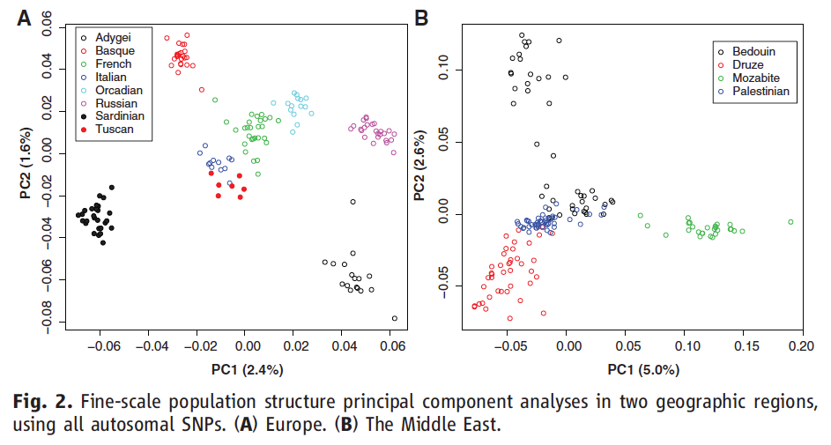
population structure
Project SNPs in reduced dimensional space.
Clumps of individuals represent population structure
Li et al (2008) Science

Slide 24
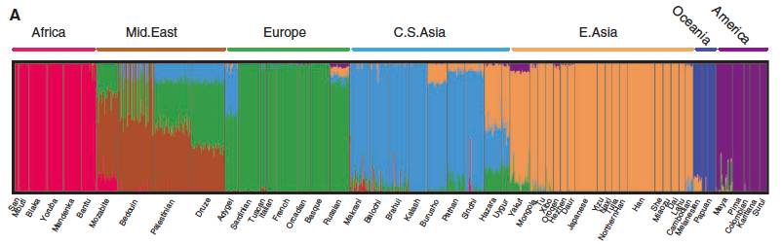
Model based assignment of individuals to populations
a priori decide on the number of likely ancestral populations
use an evolutionary genetics model to assign the most likely ancestry to each individual

Slide 25
Assignment: Rice population structure and GWAS
For this population structure and GWAS labs your assignment will be due as a Lab Report
  See template on SmartSite
          Abstract (~100 words)
          Give a brief overview of the study and conclusions
          Intro (~ 250 words)
          Provide background information about the experiment.
          Explain the question(s) that you were trying to address and why these are interesting.
          Results (~500 words)
          What did you find? Reference relevant figures or tables here
          Methods (~250 words)
          What methods were used for the analysis?
          Conclusion (~250 words)
          Summarize what you can conclude from your findings.

Slide 26
Questions to be considered:
Is there population structure?
  How does structure relate to region of origin?
  How does structure relate to amylose content?
  How does structure relate to Aluminum tolerance
Are there GWAS hits for the trait you are studying (TBD)?
What are the candidate genes for your GWAS hit?

Slide 27
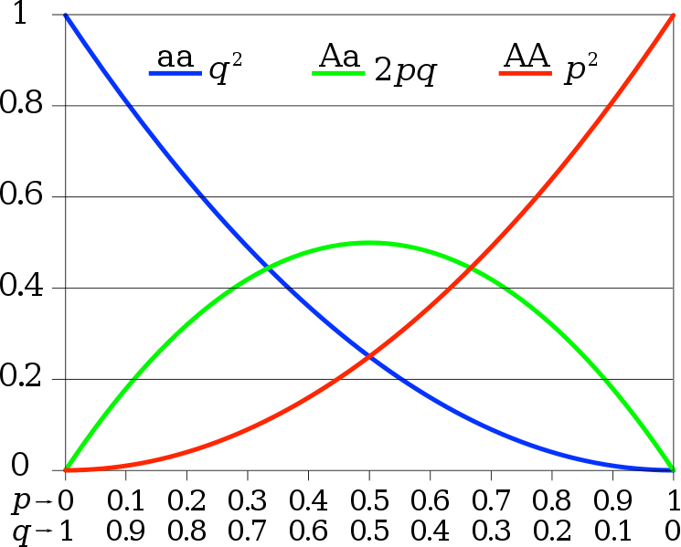
Hardy-Weinberg
Given allele frequencies A = p and a = q, genotype frequencies should be
  AA = p²
  Aa = 2pq
  aa = q²
Assumes
  Random mating
  No selection
  No mutation
  No migration
Does a subdivided population mate randomly?
http://en.wikipedia.org/wiki/File:Hardy-Weinberg.svg

Slide 28
Hardy-Weinberg example
Flower color gene
  RR: red
  Rr: pink
  rr: white
Sample 100 flowers: 10 white, 60 pink, 30 red
Allele frequencies:
  r: 80 alleles / 200 = 0.4 ; R: 120 / 200 = 0.6
Expected genotype frequencies under HWE:
  r² = .16 (expect 16 white)
  2 * r * R = .48 (expect 48 pink flowers)
  R² = .36 (expect 36 red)
Conclusions? Explanations?

Slide 29

Fst as a measure of population differentiation
Multiple definitions for Fst
Question is the same: are sub-populations differentiated
Measure average nucleotide difference within a populations and between:
Higher Fst means more pop. structure

