Slide 1
BIS180L
Genome-Wide Association Mapping
Professor MALOOF
jnmaloof@ucdavis.edu

Slide 2
Association Mapping
Goals
  find genes associated with traits
    humans: disease, disease susceptibility, other traits
    crops: yield, stress resilience, quality, disease resistance
    ecology, evolution: traits related to fitness
  assess relative risk based on genotype (personalized medicine)
Association mapping
  look at associations at a few loci (you have a priori candidates)
Genome Wide Association Mapping (GWAS)
  scan the whole genome for associations
Takes advantage of historical recombination

Slide 3
Lecture Outline
Association Mapping
Genome-Wide Association Mapping (GWAS)
The problem of population structure
QQ plot

Slide 4
Association Mapping
Trying to find genetic basis for a trait or disease
Look for statistical association between a SNP allele state and a phenotype

Slide 5
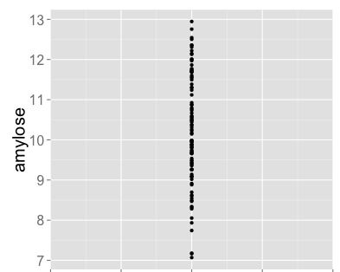
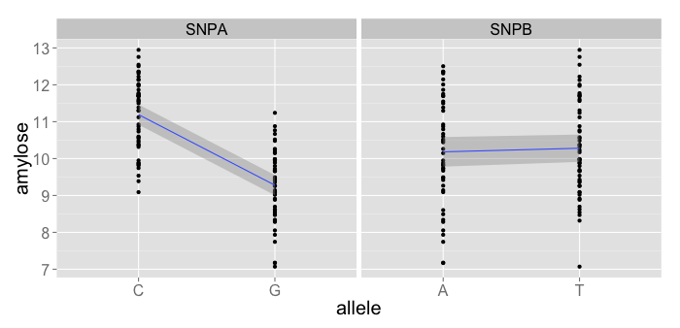
Association Mapping, simulated example for amylose
Measure amylose in many rice varieties
Separate measurements according to SNP allele
Test for association. Slope not equal to 0 = association.

Slide 6
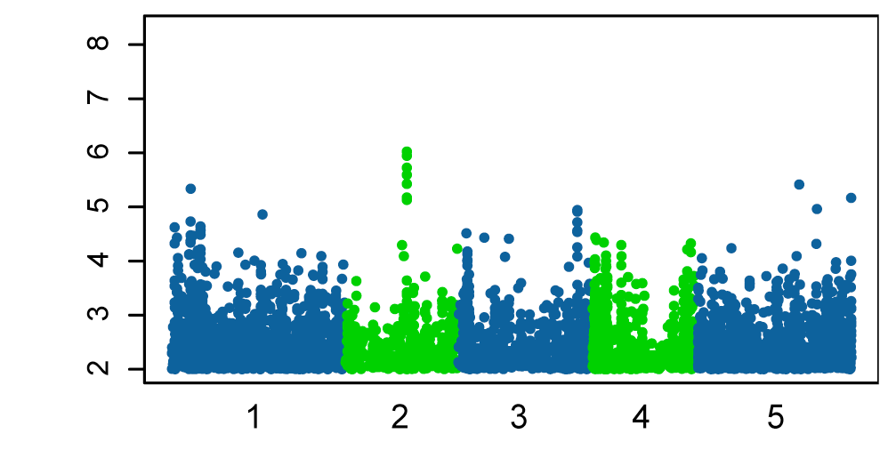
Association Mapping vs Genome-Wide Association Mapping
For GWAS repeat the analysis for SNPs across the whole genome.
Can plot the results as a manhattan plot:
  each point is a SNP
  X-axis is position in the genome. In this case there are 5 chromosomes
  Y-axis is -log10(P) for association with the trait. Higher values are more significant.
Chromosome
Filiault & Maloof, 2012

Slide 7
Association Mapping: historical recombination
Why might some SNPs be associated with a trait and not others?
Historical Recombination!

Slide 8
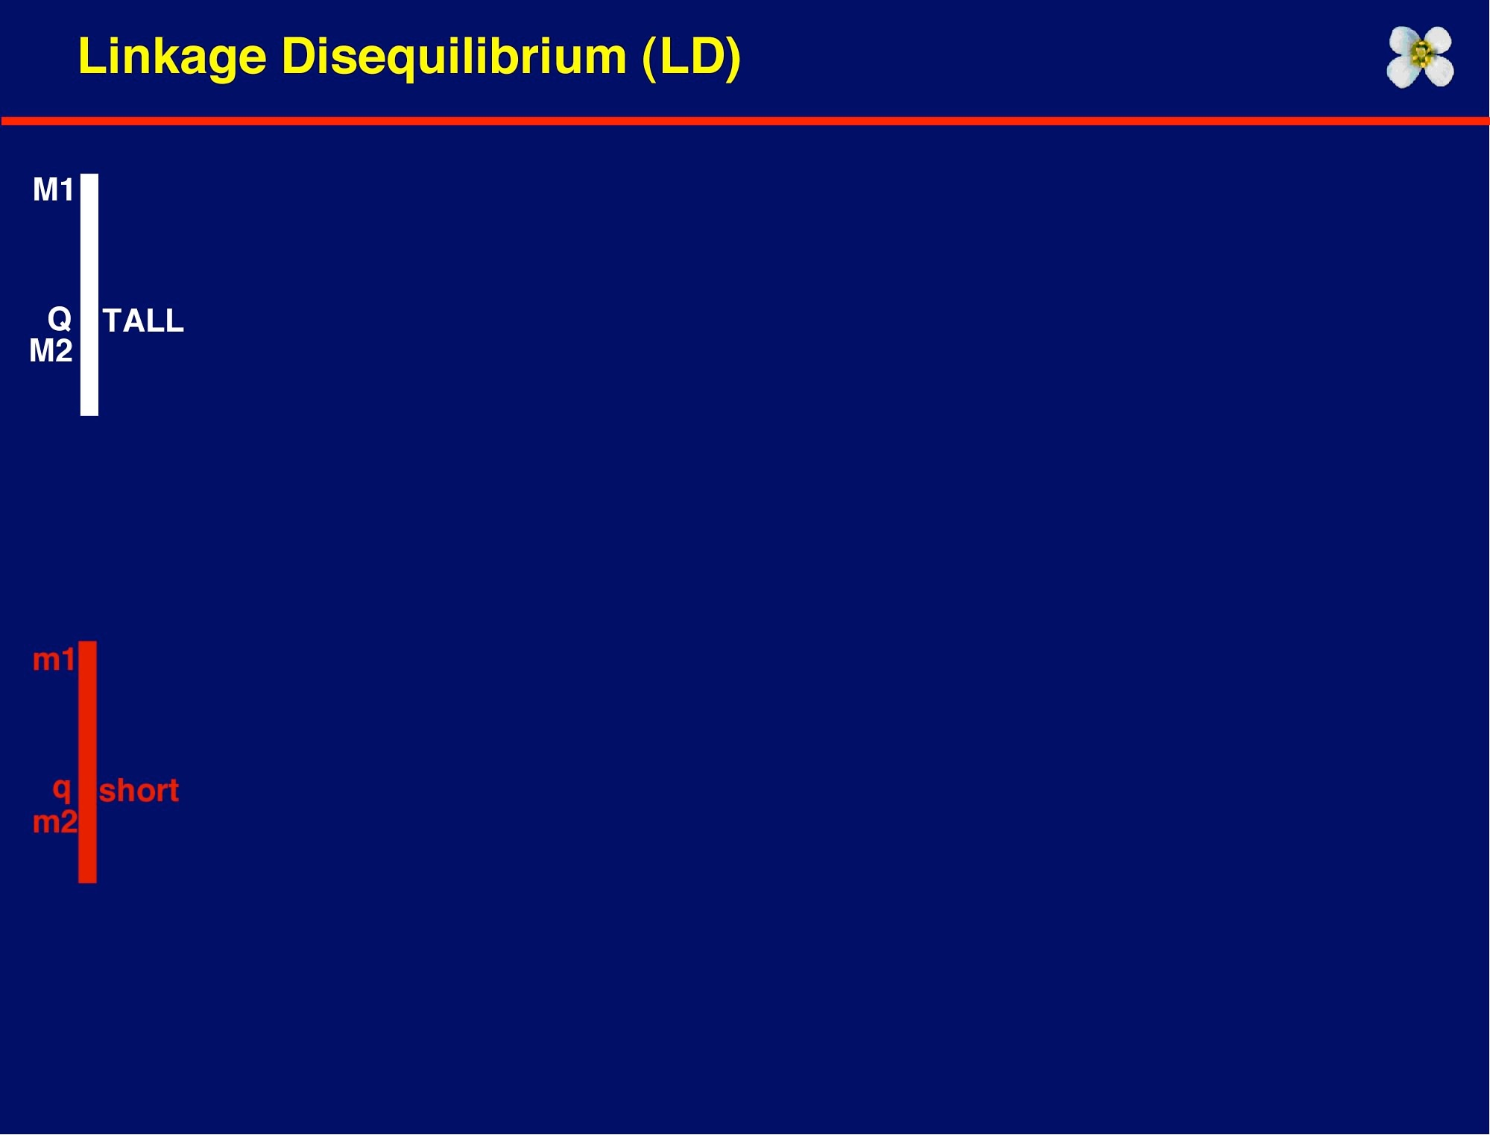
LD Tutorial II
Association mapping and historical recombination
High amylose
low amylose

Slide 9
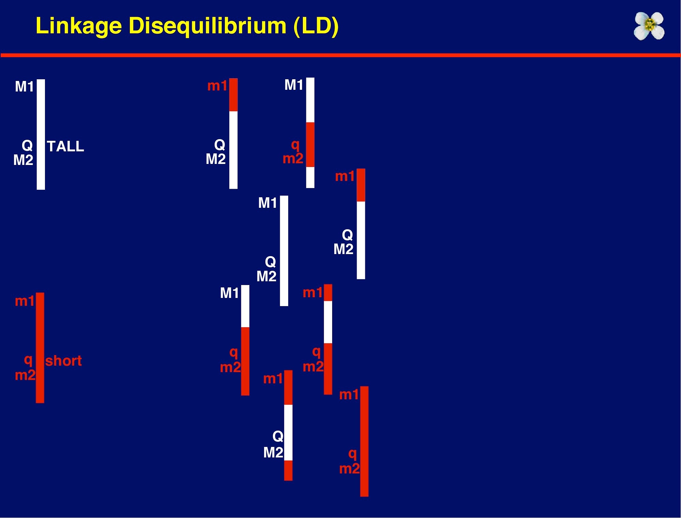
LD Tutorial III
Association mapping and historical recombination
High amylose
low amylose

Slide 10
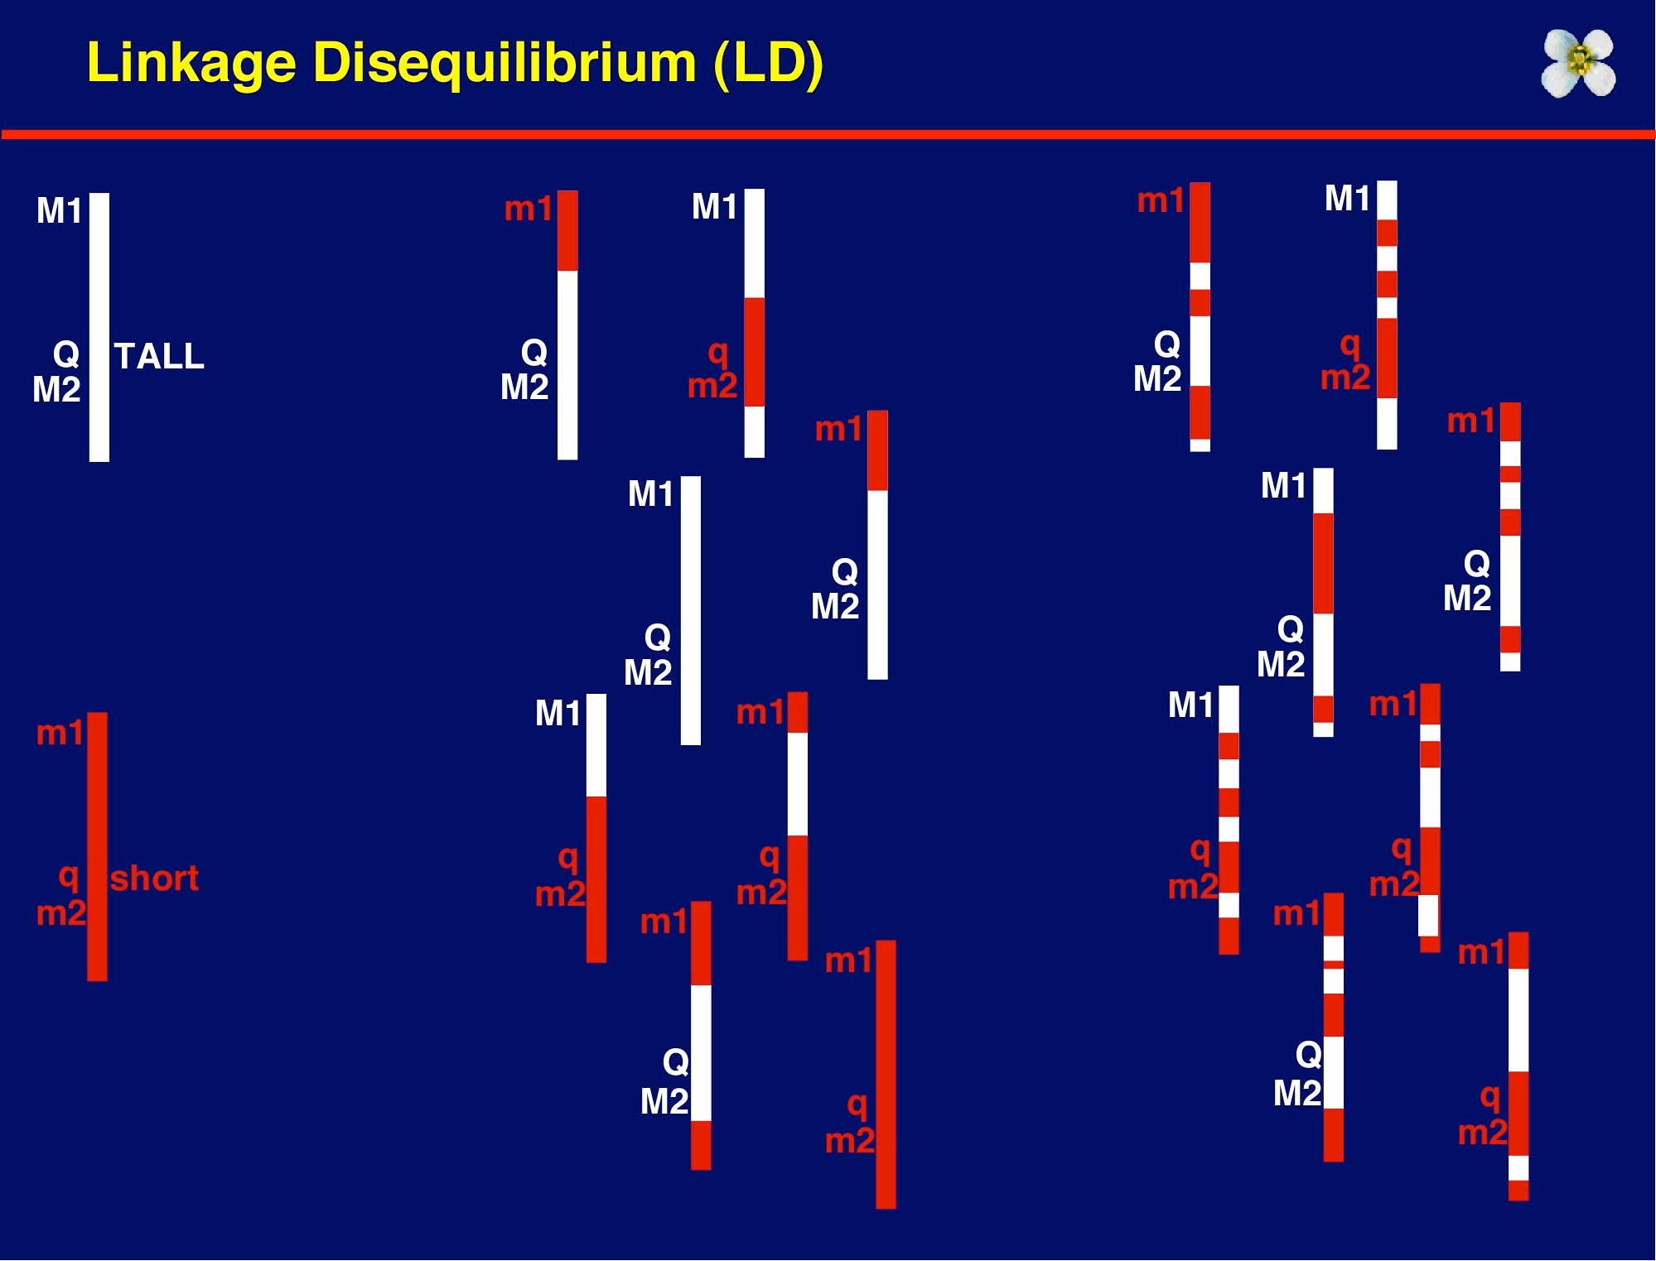
LD Tutorial IV
Association mapping and historical recombination
High amylose
low amylose

Slide 11
The importance of tagSNPs
Our rice SNP data set has ~44,000 SNPs.
There are ~500,000 SNPs segregating among the rice varieties.
Is it hopeless?
  Do we have less than a 1 in 10 chance of finding an association because we are assaying less than 10% of the SNPs?
Not hopeless
  Because of linkage disequilibrium there is a strong correlation among closely linked SNPs

Slide 12
LD Tutorial IV
Not hopeless: SNPs near to one another are correlated...
High amylose
low amylose

Slide 13
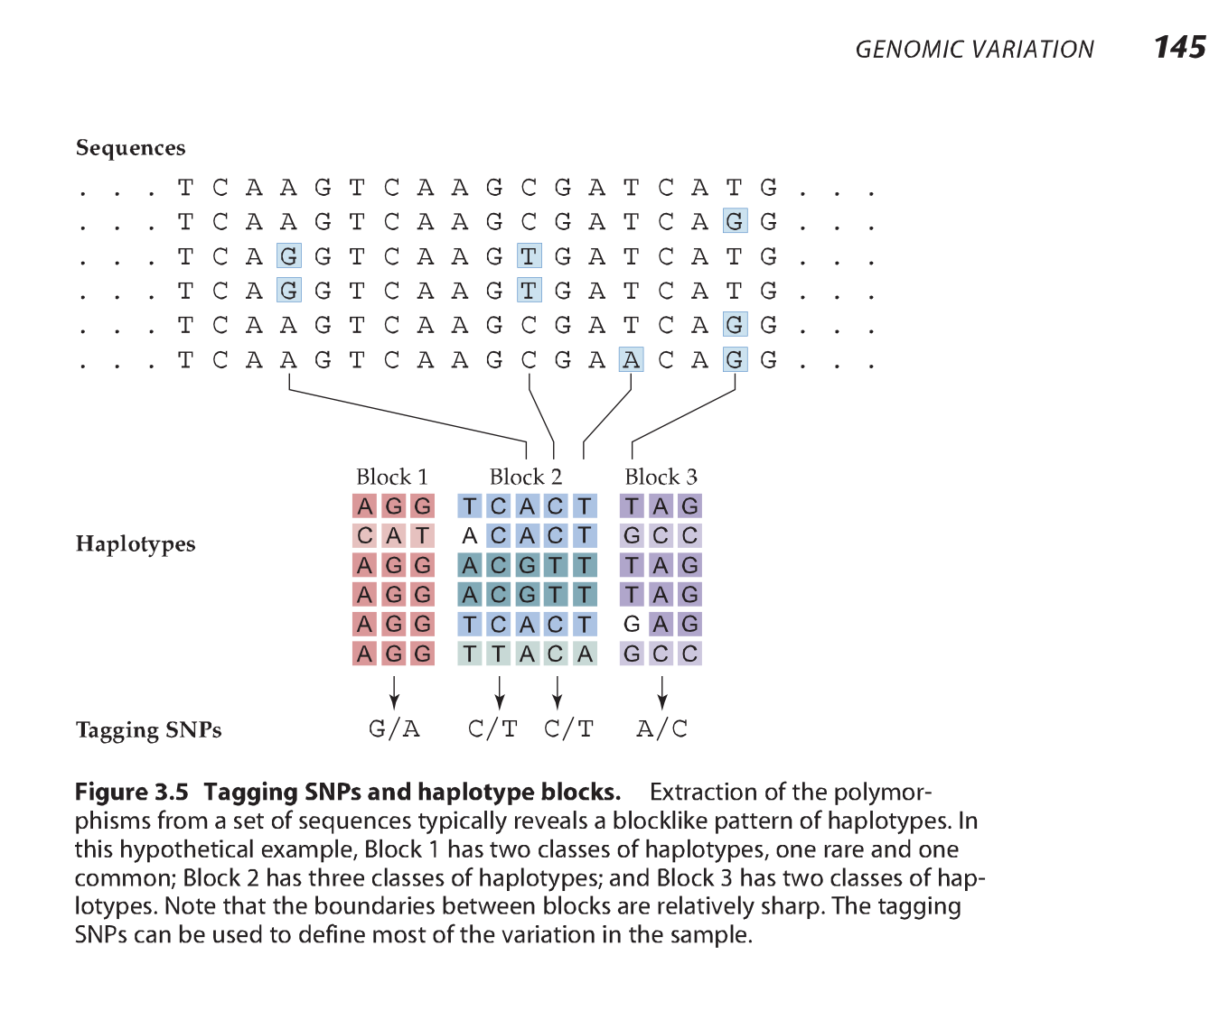
LD Tutorial IV
Not hopeless: SNPs near to one another are correlated...

Slide 14
Measuring Linkage Disequilibrium
How many SNPs is enough?
We need to know the extent of linkage disequilibirum.
There are several measures of this, we will focus on a simple one, r², or the squared correlation coefficient.

Slide 15
Consider a region with 5 SNPs
SNP1 | SNP2 | SNP3 | SNP4 | SNP5
A | G | C | A | G
A | G | G | C | T
T | C | C | A | G
A | G | G | C | T
A | G | G | C | T
T | C | C | C | T
A | G | G | C | T
T | G | C | A | G
A | G | G | C | G
A | G | G | A | G
A | G | C | C | G
A | G | G | A | G
A | G | G | A | G
T | C | C | C | T
T | C | C | C | T
T | G | G | A | G
T | C | C | A | G
T | C | C | C | T
A | G | G | A | G
T | G | G | A | G

Slide 16
These SNPs can be represented as 0s and 1s
SNP1 | SNP2 | SNP3 | SNP4 | SNP5
A | G | C | A | G
A | G | G | C | T
T | C | C | A | G
A | G | G | C | T
A | G | G | C | T
T | C | C | C | T
A | G | G | C | T
T | G | C | A | G
A | G | G | C | G
A | G | G | A | G
A | G | C | C | G
A | G | G | A | G
A | G | G | A | G
T | C | C | C | T
T | C | C | C | T
T | G | G | A | G
T | C | C | A | G
T | C | C | C | T
A | G | G | A | G
T | G | G | A | G
SNP1 | SNP2 | SNP3 | SNP4 | SNP5
0 | 1 | 0 | 0 | 0
0 | 1 | 1 | 1 | 1
1 | 0 | 0 | 0 | 0
0 | 1 | 1 | 1 | 1
0 | 1 | 1 | 1 | 1
1 | 0 | 0 | 1 | 1
0 | 1 | 1 | 1 | 1
1 | 1 | 0 | 0 | 0
0 | 1 | 1 | 1 | 0
0 | 1 | 1 | 0 | 0
0 | 1 | 0 | 1 | 0
0 | 1 | 1 | 0 | 0
0 | 1 | 1 | 0 | 0
1 | 0 | 0 | 1 | 1
1 | 0 | 0 | 1 | 1
1 | 1 | 1 | 0 | 0
1 | 0 | 0 | 0 | 0
1 | 0 | 0 | 1 | 1
0 | 1 | 1 | 0 | 0
1 | 1 | 1 | 0 | 0

Slide 17
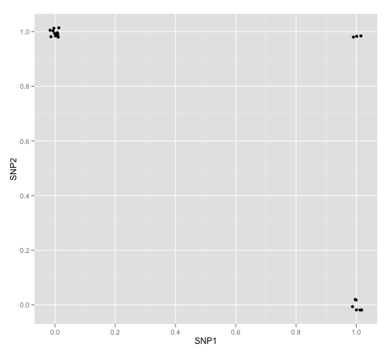
You can make an X,Y plot of each pair of SNPs
SNP1 | SNP2 | SNP3 | SNP4 | SNP5
0 | 1 | 0 | 0 | 0
0 | 1 | 1 | 1 | 1
1 | 0 | 0 | 0 | 0
0 | 1 | 1 | 1 | 1
0 | 1 | 1 | 1 | 1
1 | 0 | 0 | 1 | 1
0 | 1 | 1 | 1 | 1
1 | 1 | 0 | 0 | 0
0 | 1 | 1 | 1 | 0
0 | 1 | 1 | 0 | 0
0 | 1 | 0 | 1 | 0
0 | 1 | 1 | 0 | 0
0 | 1 | 1 | 0 | 0
1 | 0 | 0 | 1 | 1
1 | 0 | 0 | 1 | 1
1 | 1 | 1 | 0 | 0
1 | 0 | 0 | 0 | 0
1 | 0 | 0 | 1 | 1
0 | 1 | 1 | 0 | 0
1 | 1 | 1 | 0 | 0

Slide 18
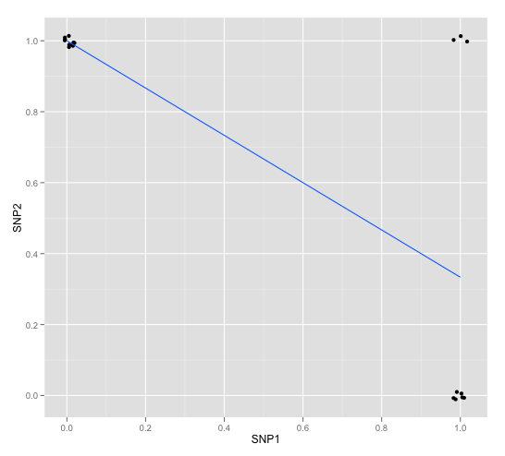
Calculate correlation coefficient as measure of LD
SNP1 | SNP2 | SNP3 | SNP4 | SNP5
0 | 1 | 0 | 0 | 0
0 | 1 | 1 | 1 | 1
1 | 0 | 0 | 0 | 0
0 | 1 | 1 | 1 | 1
0 | 1 | 1 | 1 | 1
1 | 0 | 0 | 1 | 1
0 | 1 | 1 | 1 | 1
1 | 1 | 0 | 0 | 0
0 | 1 | 1 | 1 | 0
0 | 1 | 1 | 0 | 0
0 | 1 | 0 | 1 | 0
0 | 1 | 1 | 0 | 0
0 | 1 | 1 | 0 | 0
1 | 0 | 0 | 1 | 1
1 | 0 | 0 | 1 | 1
1 | 1 | 1 | 0 | 0
1 | 0 | 0 | 0 | 0
1 | 0 | 0 | 1 | 1
0 | 1 | 1 | 0 | 0
1 | 1 | 1 | 0 | 0

Slide 19
Calculate squared correlation coefficient (r²) as measure of LD
SNP1 | SNP2 | SNP3 | SNP4 | SNP5
0 | 1 | 0 | 0 | 0
0 | 1 | 1 | 1 | 1
1 | 0 | 0 | 0 | 0
0 | 1 | 1 | 1 | 1
0 | 1 | 1 | 1 | 1
1 | 0 | 0 | 1 | 1
0 | 1 | 1 | 1 | 1
1 | 1 | 0 | 0 | 0
0 | 1 | 1 | 1 | 0
0 | 1 | 1 | 0 | 0
0 | 1 | 0 | 1 | 0
0 | 1 | 1 | 0 | 0
0 | 1 | 1 | 0 | 0
1 | 0 | 0 | 1 | 1
1 | 0 | 0 | 1 | 1
1 | 1 | 1 | 0 | 0
1 | 0 | 0 | 0 | 0
1 | 0 | 0 | 1 | 1
0 | 1 | 1 | 0 | 0
1 | 1 | 1 | 0 | 0
 | SNP1 | SNP2 | SNP3 | SNP4 | SNP5
SNP1 | 1 | 0.5184 | 0.36 | 0.01 | 0.0064
SNP2 | 0.5184 | 1 | 0.5184 | 0.0484 | 0.1296
SNP3 | 0.36 | 0.5184 | 1 | 0.01 | 0.0064
SNP4 | 0.01 | 0.0484 | 0.01 | 1 | 0.6724
SNP5 | 0.0064 | 0.1296 | 0.0064 | 0.6724 | 1

Slide 20
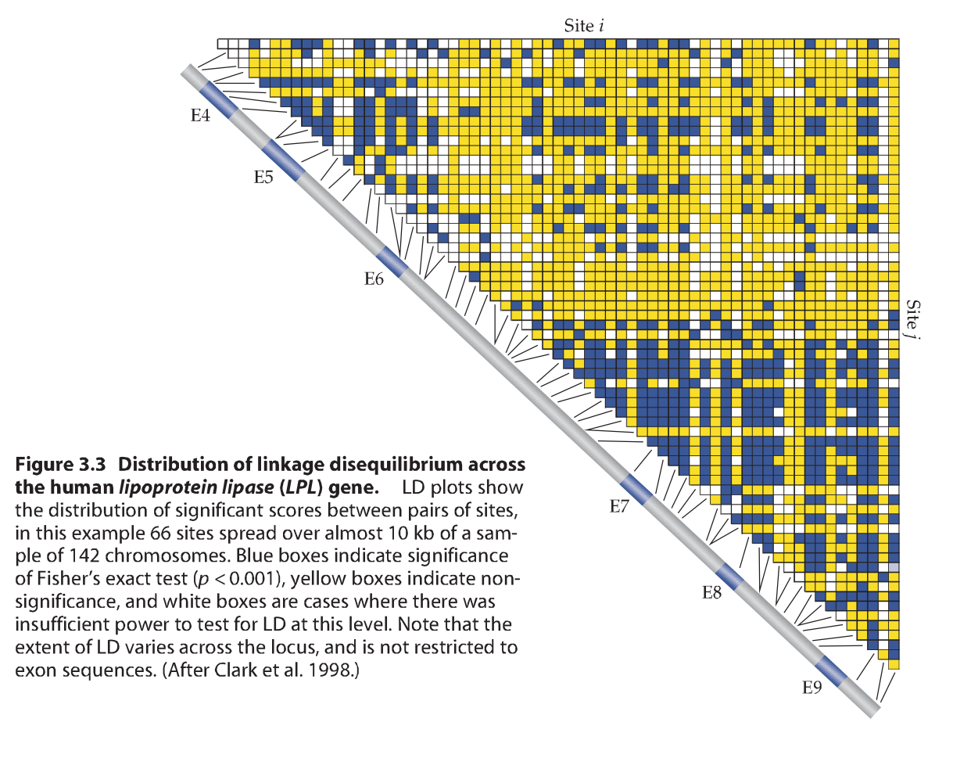
Can visualize LD across a genomic region by plotting a heat map of these r² values
 | SNP1 | SNP2 | SNP3 | SNP4 | SNP5
SNP1 |  | 0.5184 | 0.36 | 0.01 | 0.0064
SNP2 |  |  | 0.5184 | 0.0484 | 0.1296
SNP3 |  |  |  | 0.01 | 0.0064
SNP4 |  |  |  |  | 0.6724
SNP5

Slide 21
LD: Summary
Because of LD, nearby SNP genotypes are correlated
The extent of LD depends on the amount of historical recombination
The extent of LD determines the range over which a SNP might be informative for association mapping
r² can be used to measure LD

Slide 22
the problem of population structure
If a trait is correlated with population structure then many spurious associations will result.
What if GWAS for hair color in Spain + Sweden?
Ancestral Population
Population differentiation,
genetic drift at many loci
Modern Spain
Modern Sweden
Because the Spanish and Swedish populations have been separated for a long time they will differ at many, many loci due to drift.
Almost none of these will have anything to do with hair color, but many of them will be associated with hair color in a GWAS due to population structure.

Slide 23
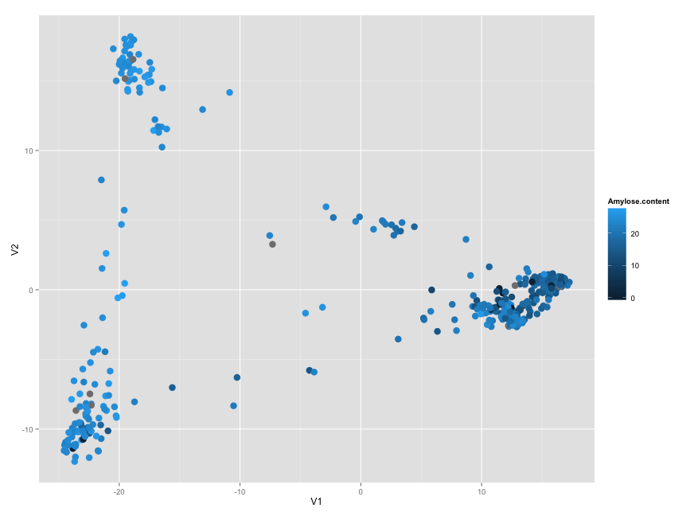
Population Structure can present a problem for GWAS
What is the potential problem with a GWAS for amylose content?

Slide 24
Population structure corrections
Do GWAS separately for each sub-population
          OR
Include population information in the statistical GWAS model.

Slide 25
Include population structure information in GWAS model
Three ways to include structure information:
“Q” matrix
  population assignment, e.g. from fastStructure
Genotype principal components
  Like the PCs we generated in the last lab
Kinship matrix (“K”)
  Matrix of pairwise genetic relatedness (in our case 413 X 413 matrix)
  Values represent genetic similarity and range from 0 to 1
    Identical twins have kinship = 1
    Siblings or parent/children have kinship = 0.5
    Half-siblings have kinship = 0.25
  If you don’t know pedigree (we don’t), then the Kinship matrix can be estimated from the SNPs

Slide 26
Include population structure information in GWAS model
In formula notation:
  amylose ~ SNPgenotype (no correction)
  amylose ~ SNPgenotype + Q (population membership)
  amylose ~ SNPgenotype + K (kinship matrix)
  amylose ~ SNPgenotype + Q + K
The statistical test is whether SNP is associated with amylose BEYOND what is expected given Q or K
Often it is best to include BOTH Q and K

Slide 27
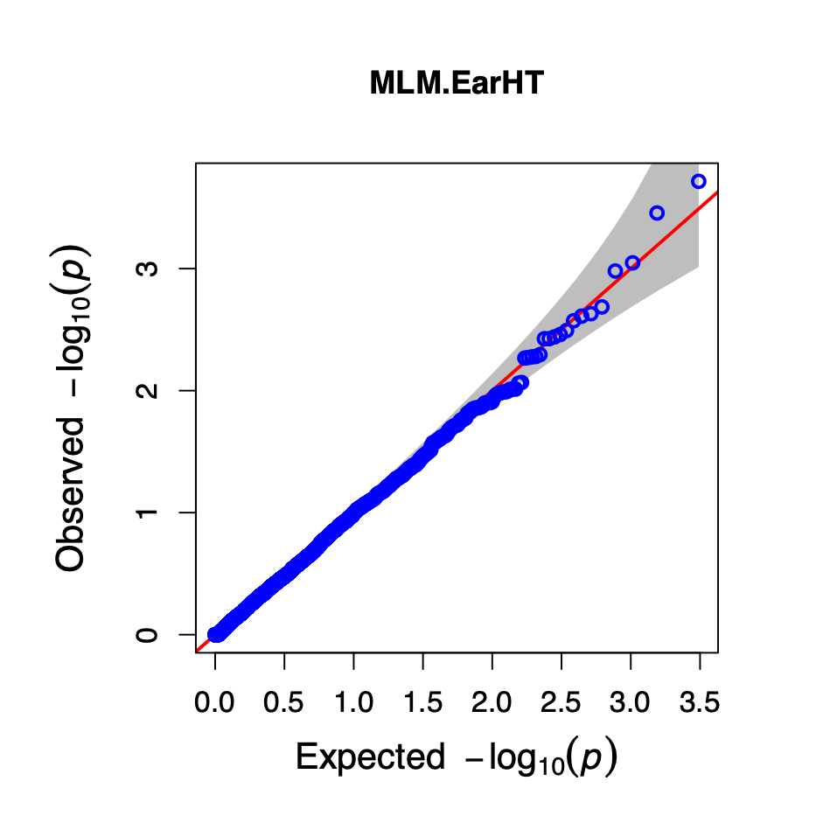
Q-Q Plot
Q-Q plots can be used to determine if population structure correction is working
Plots observed -log10 p-value VS -log10 p-value expected if no associations
Because the VAST majority of the SNPs should not influence the trait, we expect the points to be on the 1:1 diagonal except at the very right hand side of the plot.
Example of a good Q-Q plot

