Slide 1
April 21

Slide 2
Just at the very end here, I was confused as to why we would probably see SNPs with high expected -log10 p-value diverge from the 1:1 diagonal that the rest of the SNPs fall onto even if the population structure correction was working. This confusion may be coming from what we mean by "expected" in this case. Thanks!
Expected assumes no GWAS hits.
IF there are true, strong GWAS hits, those hits will have high -log10(p) and so observed –log10(p) will be higher than expected (above the diagonal).

Slide 3
What could be problematic in GWAS to consider besides the population structure and low-coverage SNP data?
  Heritability of the trait
  Confounding factors (socio-economic, lifestyle, etc).
  Sample Size
  Sample bias (white males)
  Challenges of over-correction of population structure
  Rare variants.
  Multiple disease-causing alleles.
  Structural variants (hard to assay by Illumina or SNP-chip/bead assays)
  Small effect sizes
  Additive model assumptions

Slide 4
I heard that the strict statistical p-value cutoff can be the case which sometimes makes us ignore the potential biological information on those SNPs with high association but don't reach the cutoff value. Is that true?
  Yes, especially as the number of tested SNPs reaches into the tens of millions or more. Bonferroni can set an impossibly high bar.
And how should we deal with this issue when we deal with data analysis?
  Adjust for effective number of tests/markers, not true number.
  FDR (but cost of follow-up on false positives)
  Permutation thresholds (but compute cost)
  Repeated, independent studies

Slide 5
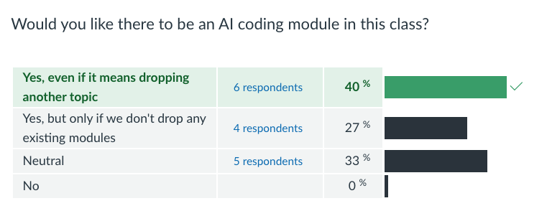

Slide 6
